Slide 1



Slide 2

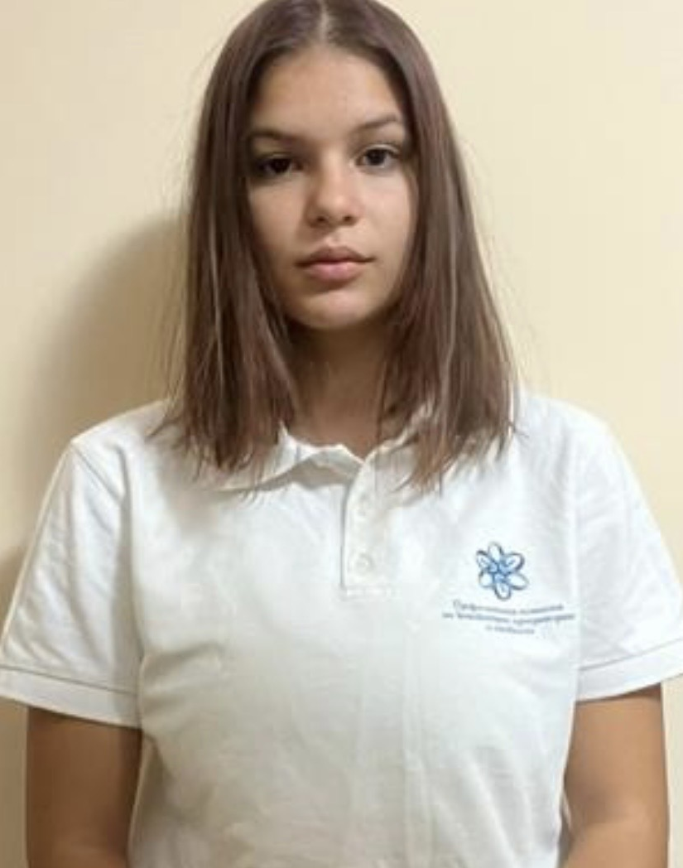
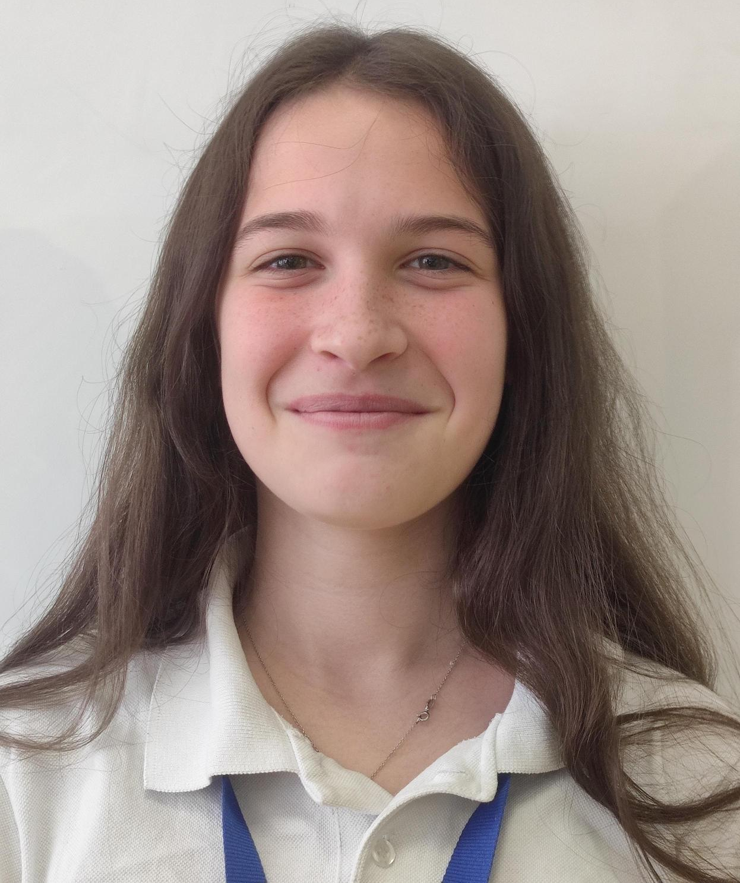
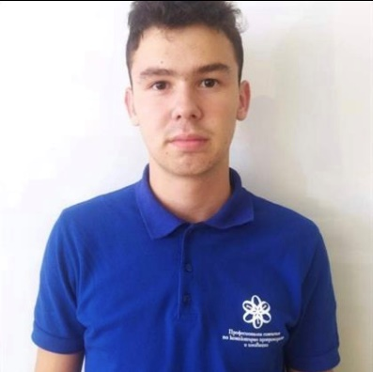
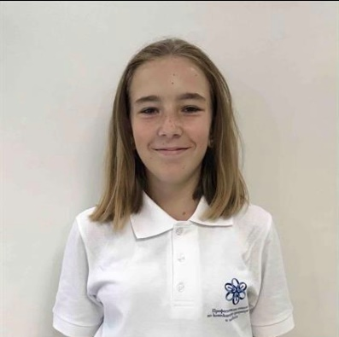
1. Our Team
Nikoleta Ruseva
Scrum Trainer
Mariela
Dimova
Frontend developer
Kaloyan Georgiev
Backend developer
Bilyana Badalova
QA Engineer

Slide 3

2. Stages
Choose an idea.
Make a design.
Make an application.
Make documentation.

Slide 4









2. Used Programs

Slide 5
Let’s get to the application

