Slide 1

Maths-coders

Slide 2
TABLE OF CONTENTS
01
Our team
03
THE IDEA
02
Our steps at work
04
What did we use?

Slide 3
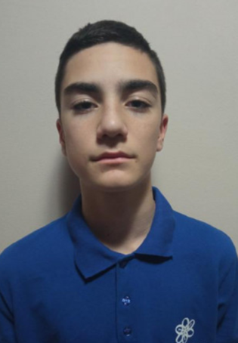
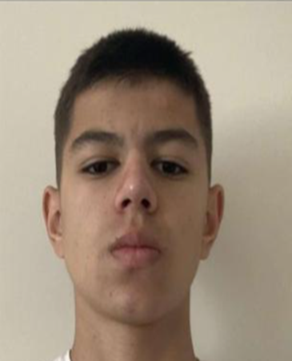
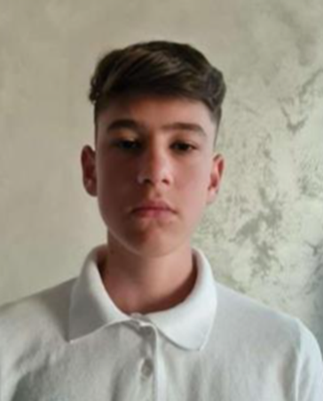
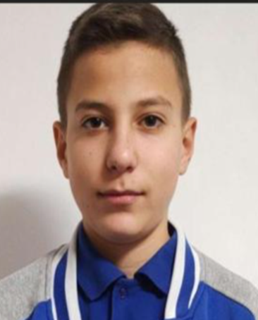
OUR TEAM
Radomir Aleksandrov 9A
Stanimir Popov 9B
Enis Mustafa 9V
Stilian
Georgiev 9G
Scrum Trainer
QA Engineer
Back-end
Developer
Front-end
Developer

Slide 4
Our steps at work
Idea
Realization
Idea and explanation
Ways of implementation.
Team
Used technologies
Distribution of duties.​
Distribution of duties.​
Choice of technologies.​

Slide 5
THE IDEA
- The idea is to solve the task
- Good luck, only with a solved task you can drive the car!

Slide 6






What did we use?

Slide 7
Thanks for the attention!

Slide 8
Now let's see the Repo.

