Slide 1


Slide 2



TABLE OF CONTENT

Slide 3
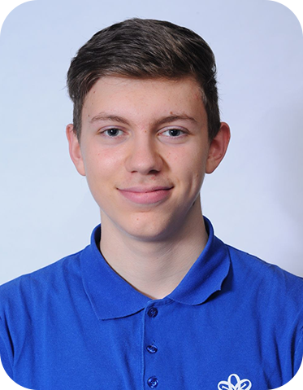
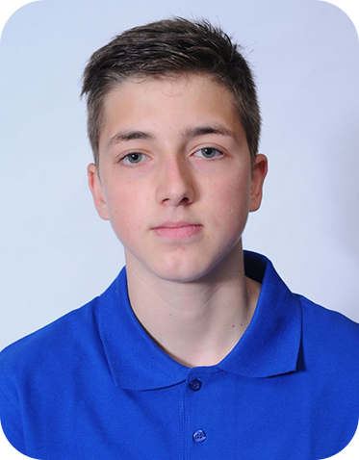
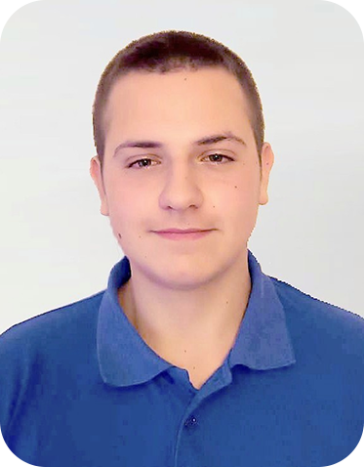
Our Team
Ivan Tsvyatkov
QA Developer
Dimitar Byandov
Frontend Developer & Backend Developer
Stiliyan Mishev
Scrum Trainer

Slide 4




Stages

Slide 5







Used Programs

Slide 6

Let's jump to the game ☺

