Slide 1
Space match
by Open-minded

Slide 2
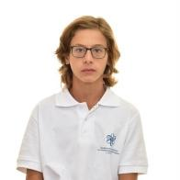
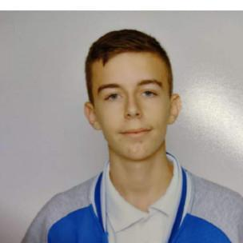
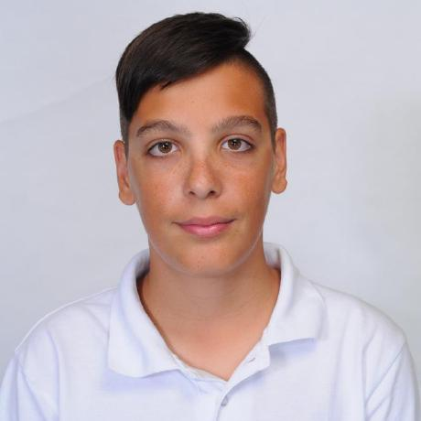
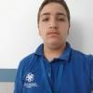
OUR TEAM
Ivo Badalov
Teodor Tanev
Georgi Ivanov
Simeon Syarov
Scrum Trainer
Backend
Frontend
QA

Slide 3
Idea
We got inspired from the space and from the lots of movies showing asteroids destroying the Earth

Slide 4
Realization
01
Task
02
Organisation
We’ve met up with the task and we’ve chosen what our game will be about
We made a group and split the roles between us
03
Realisation
04
Test
We did the menu, then the game and some additional stuff
Our QA made tests and checked if there are any bugs

Slide 5








Used technologies

Slide 6
Let's move to the game
THANKS FOR YOUR ATTENTION

Slide 7
THANKS FOR YOUR ATTENTION

