Slide 1

Walter

Slide 2
TABLE OF CONTENTS
1. Our team
2. Our goal
3. Stages of Realization
4. Used Technologies

Slide 3
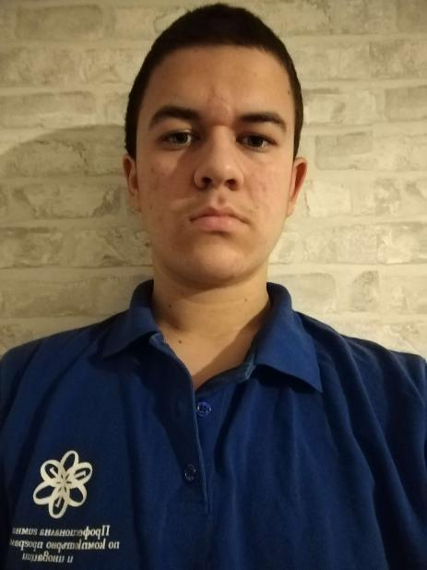


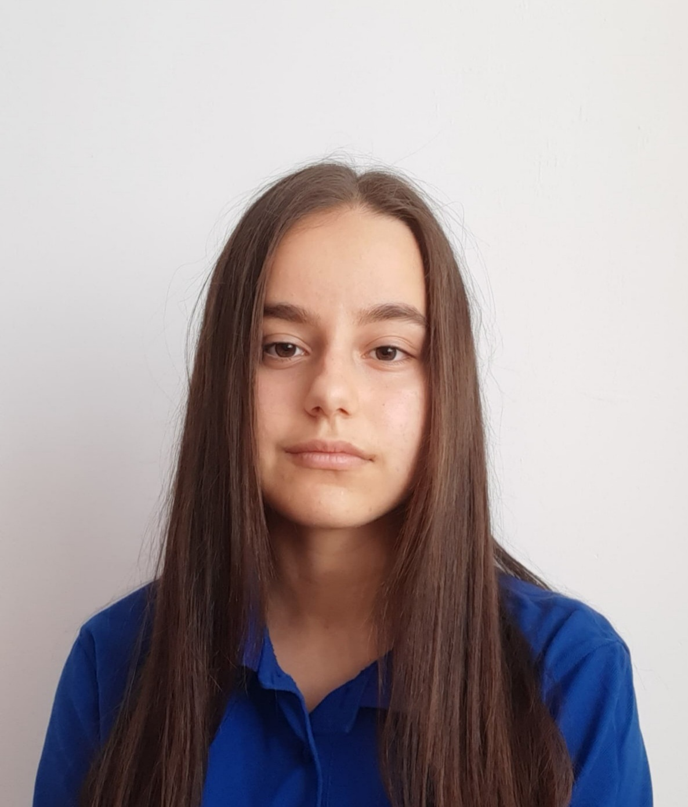
Our team
Nikolai Stoqnov
Yana Ilcheva
Front-end developer
QA engineer
Atanas Atanasov
Ivan
Delchilov
Scrum Trainer
Back-end developer

Slide 4


Our goal
Our goal is to make a game that can make learning to use the bitwise operators much easier and enjoyable.

Slide 5
Stages of realization
Organization
Decide on the idea
Development
Presentation

Slide 6







Used technologies

Slide 7
Let’s move on to the game

Slide 8
Thanks for your attention!

