Slide 1

HYDRA

Slide 2
CONTENTS
01
02
03
04
TEAM MEMBERS
STAGES OF REALIZATION
USED TECHNOLOGIES
OUR IDEA

Slide 3
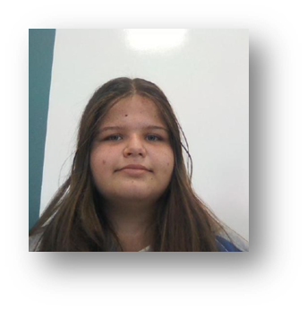
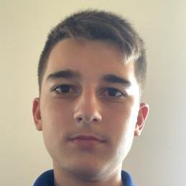
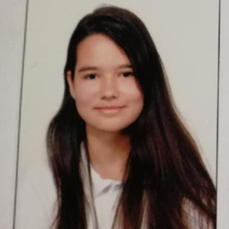
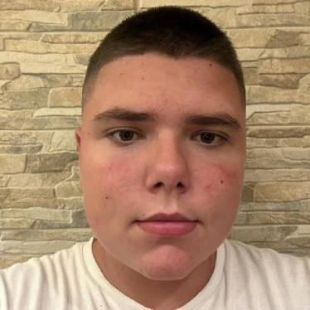
TEAM MEMBERS
Pavel Yordanov Scrum Trainer 10A
Galya Ivanova Backend Developer 10G
Nikola Stoyanov Backend Developer 10A
Petya Stoyanova QA engineer
10G

Slide 4
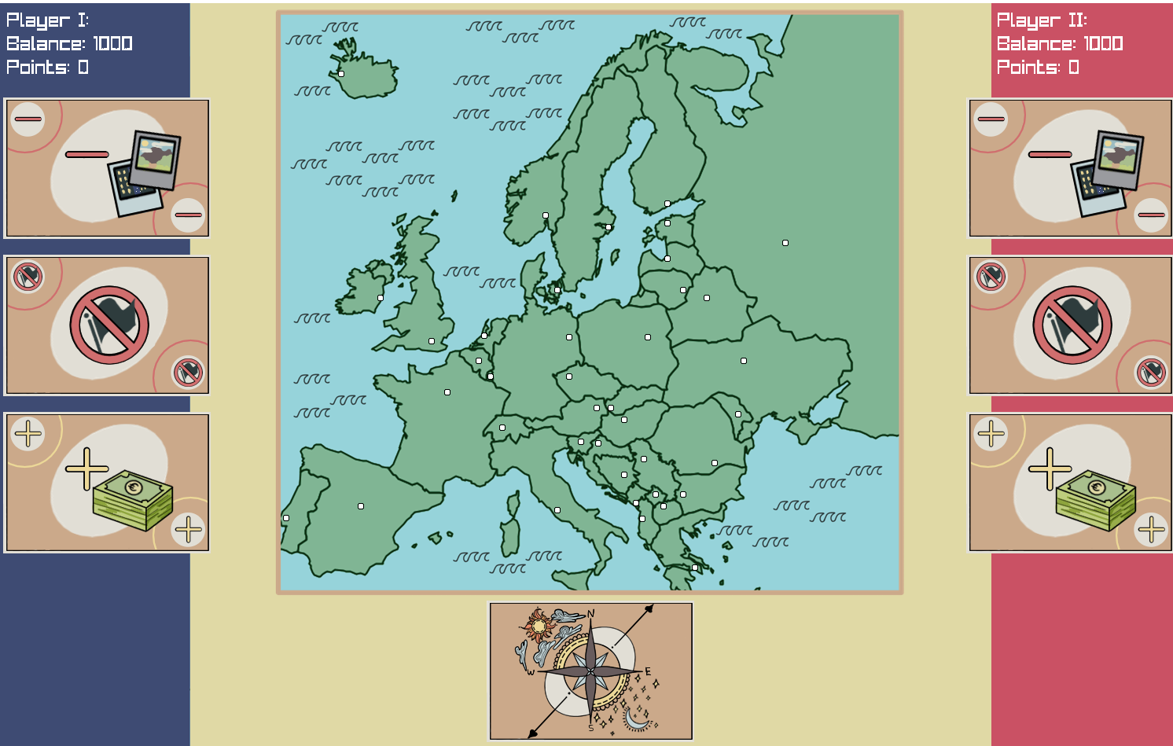
OUR IDEA

Slide 5



STAGES OF REALIZATION

Slide 6









USED TECHNOLOGIES

Slide 7
LET’S MOVE ON TO OUR GAME!

