Slide 1
Web Scraper
Mario Zlatev

Slide 2
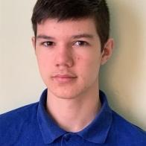
Made By:
Mario Zlatev Backend Developer

Slide 3
Idea Of The Project

Slide 4




Apps, Tools and Programming Languages I’ve Used

Slide 5
Now onto the project!

Slide 6
Thank you for your attention!

