Slide 1
Web scraper
Python project

Slide 2

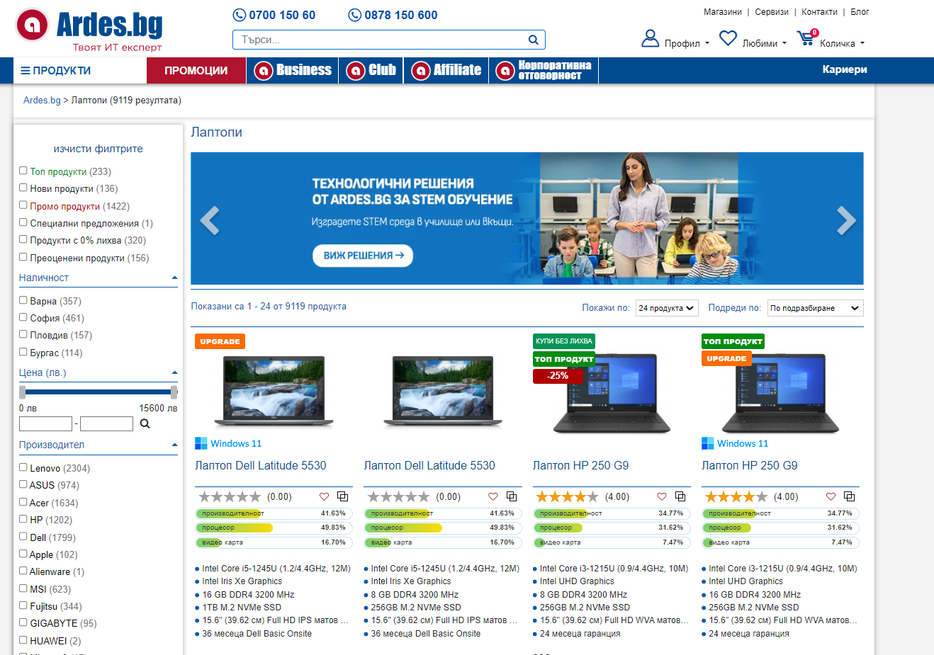
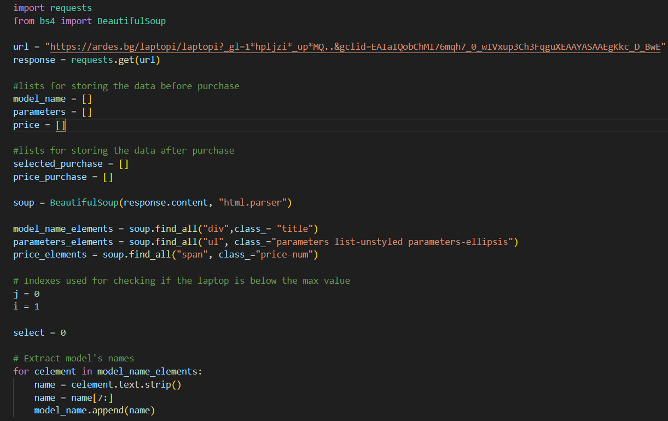
Idea

Slide 3







Technologies

Slide 4
Let’s move on to the code

