Slide 1
Web Scraper
Made by Ioan Todorov

Slide 2
01
Who am I?
02
My Idea
Table of contents
03
How does It work?
04
Used programs

Slide 3
Who am I?

Slide 4
My Idea
This is a Python script that scrapes a website, counts the occurrence of each word, and sorts them by usage. It uses the BeautifulSoup and requests libraries to retrieve the HTML content of a website and process the text data.

Slide 5
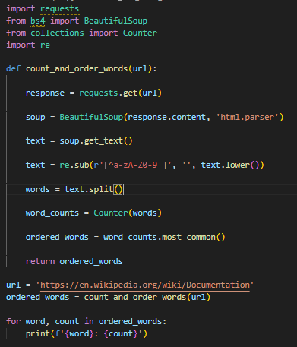
How does it work?
Sends a GET request to the provided website URL.
Retrieves the HTML content of the webpage.
Parses the HTML using BeautifulSoup to extract the text data.
Cleans the text by removing non-alphanumeric characters and converting it to lowercase.
Splits the text into individual words.
Counts the occurrence of each word using the Counter class from the collections module.
Sorts the words by their count in descending order.

Slide 6




Used programs

Slide 7
Let’s move on to the project

Slide 8
Thank you for your attention

