Slide 1
Car Rental System

Slide 2
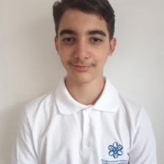
The Team
Kliment Tenev

Slide 3




Apps, Tools and Programming Languages We’ve Used

Slide 4

Idea Of The Project

Slide 5
Stages Of Progress
1.
2.
3.
4.
Creating the Repository
Coming up with the idea
I started by creating the GitHub Repository where I would commit my files.
After making the repo, I started making some basic ideas about the project.
Realizing the right idea
Creating The Presentation and writing in the workbook
After writing down the ideas I choose the best one and started doing it.
After finishing with the code I started doing the presentation and describing the project in the workbook.

Slide 6
Now onto the project

