Slide 1
Car Rental System

Slide 2
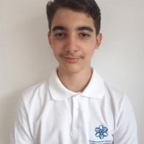
Meet the team.
Kliment Tenev Back-end

Slide 3

Idea Of The Project

Slide 4
Stages Of Progress
1.
2.
3.
4.
Coming Up With An Idea
Realizing The Idea
Checking For Errors
Creating The Presentation and filling out the workbook

Slide 5




Apps, Tools and Programming Languages We’ve Used

Slide 6
Now onto the project

Slide 7
Thank you for your attention!

