Slide 1
IOTHomeSecurity
Калоян Динев, 12 в Професионална Гимназия по Компютърно Програмиране и Иновации

Slide 2
THE IDEA

Slide 3













Tool & Technologies used

Slide 4
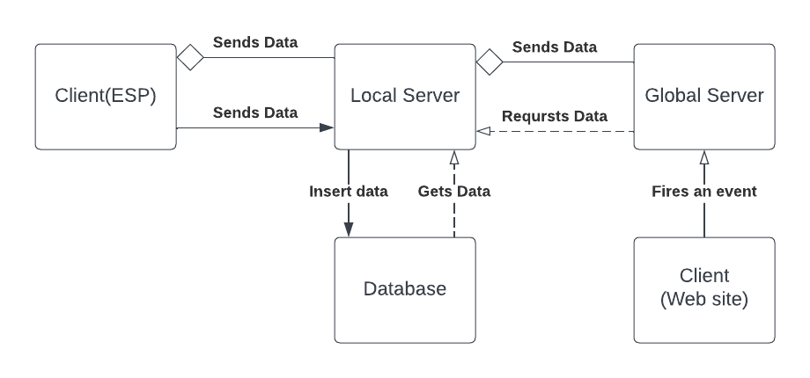
Client to Server communication

Slide 5
Demonstration

Slide 6
Future Ideas
Integration for notifications
Integration for ESP32 CAM

Slide 7
Thank you for the attention
kddinev18@codingburgas.bg

