Slide 1

ASTROWORLD

Slide 2
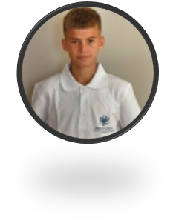
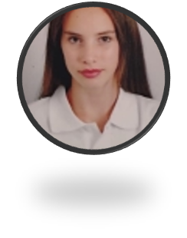

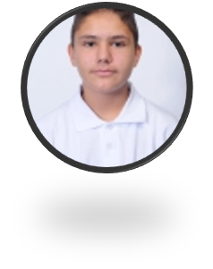
OUR TEAM
STOYAN HRISTOV
DIMAYA NONEVA
JAKLIN YANKOVA
STILYAN DIMITROV
Back-End Developer
Scrum Trainer
Back-End Developer
Back-End Developer

Slide 3

THE IDEA
This is a game about an astronaut from the planet ,,Earth” , but on his last expedition his spacecraft exploded and now his parts are scattered across the planet ,,Mars”. Your job is to help him put them together so he can go back to his loved ones and complete his mission. However, he has a certain amount of time before he runs out of oxygen, his clock is already ticking so be as fast as you can!

Slide 4
STAGES OF DEVELOPMENT
1 WEEK
2 WEEK
ORGANISATION
DESIGN
CODE
DOCUMENTS
3 WEEK
4 WEEK
Creating logo and discussing ideas about the game
Making the design
and implementing our ideas through code
Developing the code
Creating the documentation and presentation

Slide 5







SPACE EXPLORATION TIMELINE
WORD
CANVA
VISUAL STUDIO
POWER POINT
GITHUB
TEAMS

Slide 6
LET’S MOVE TO THE DEMONSTRATION

