Slide 1
E.C.C.C

Slide 2
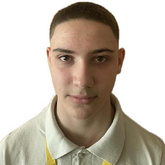
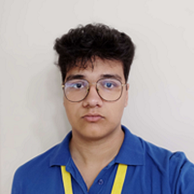
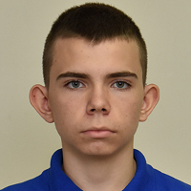
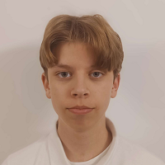
Our Team
Boris Milev
Dimitar Dimitrakov
Konstantin Nachev
Nikolai Kalashnik
Venus has a beautiful name and is the second planet from the Sun
Mercury is the closest planet to the Sun and the smallest of them all
Despite being red, Mars is actually a cold place full of iron oxide dust
Saturn is a gas giant, composed mostly of hydrogen and helium

Slide 3
Stages of Development
Forming our team
Working on the project
01
03
Our Idea
Presenting
02
04

Slide 4






Used Technology
Visual Studio
Discord
GitHub
Visual Studio Code
PowerPoint
Word

Slide 5


Now Let’s Jump to our project
Please keep this slide for attribution

