Slide 1

Planet Dawn

Slide 2
Weeks of working
01
02
03
04
Assembling the team
The process of creating
We talked about the roles, so everyone could do what they are best at. Then we started thinking of an idea.
Almost every day we called and discussed our progress. If there were any problems, we helped eachother.
Finishing the project
Presenting the product
After we were finished with the project, the documentation and presentation, we fixed some bugs and issues with the codes.
Now that we have finished the project its ready to be presented.

Slide 3
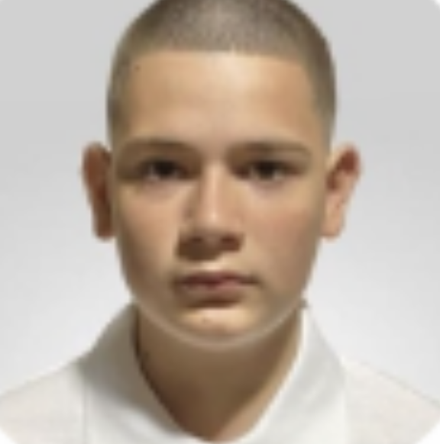
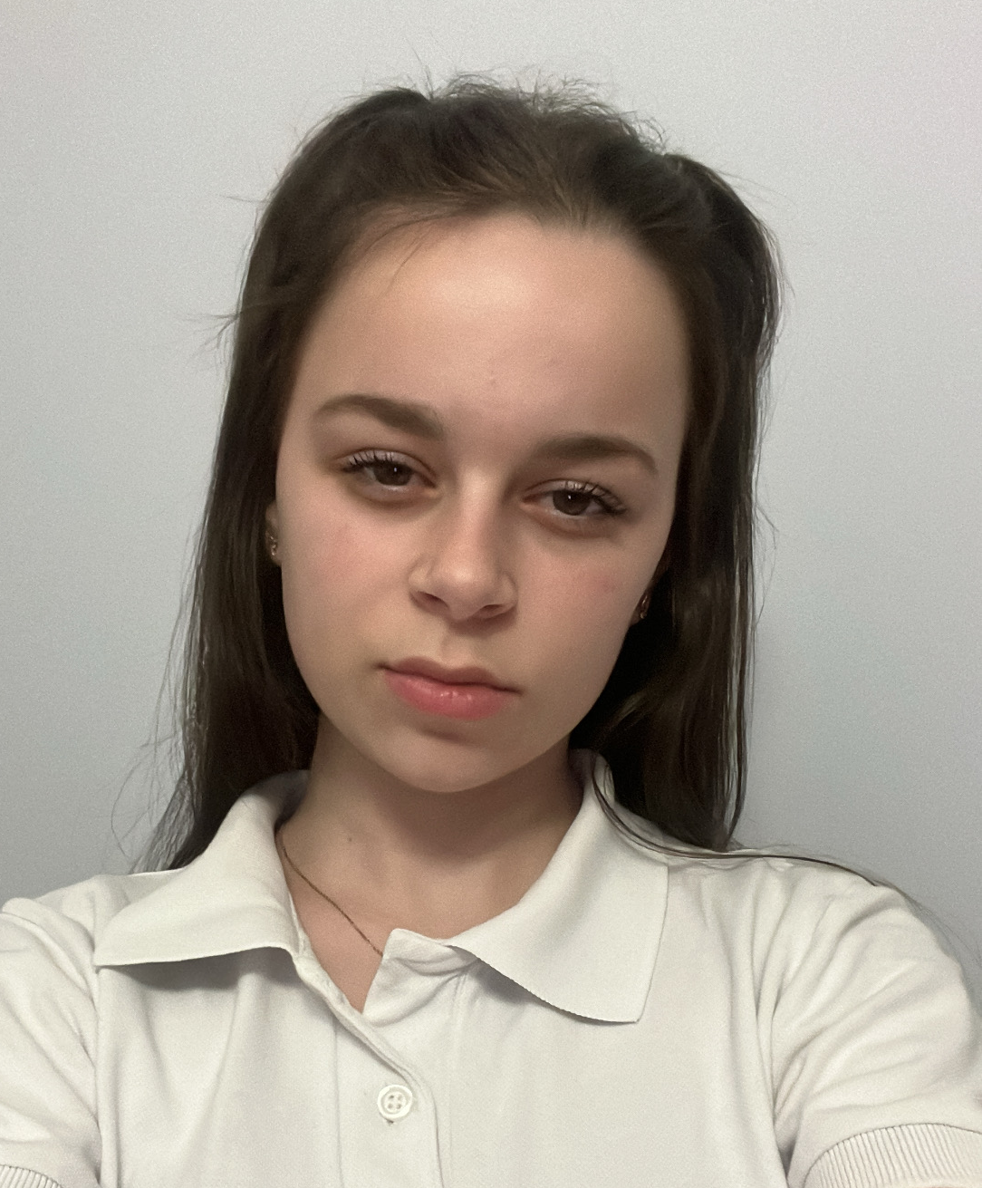
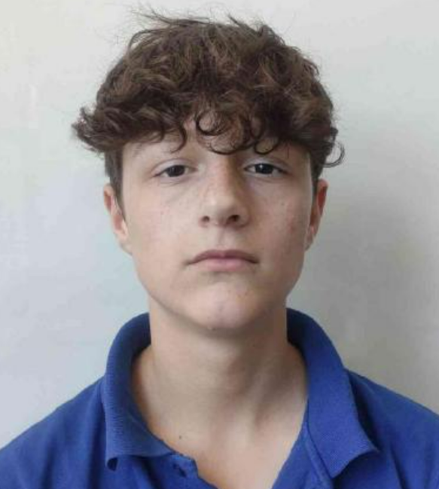
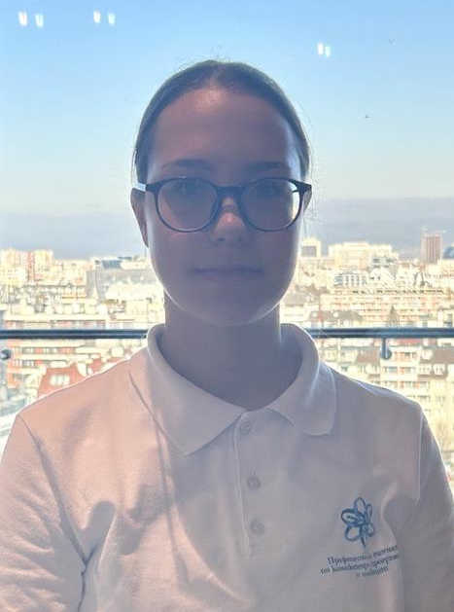
Our Team
Plamen Petkov
Dariq Kartalova
Back-end developer
Back-end developer
Dimitar Kostadinov
Ani Vezirova
Scrum trainer
Back-end developer

Slide 4







Used Technologies

Slide 5
Let’s move on to the project!

