Slide 1

TEAM UNIBOX
Project on the topic "Space Expedition"

Slide 2
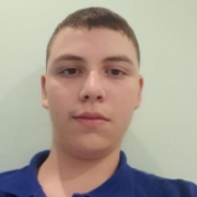
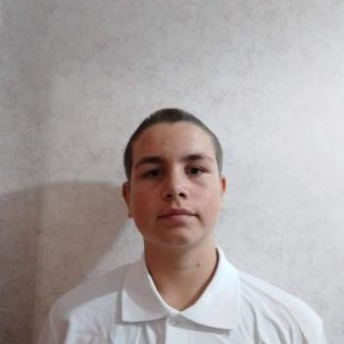
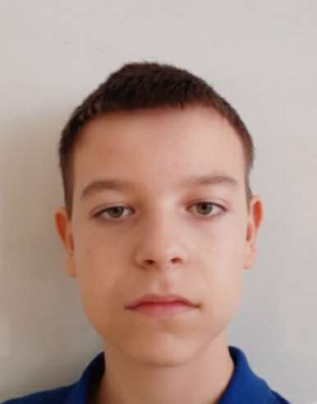
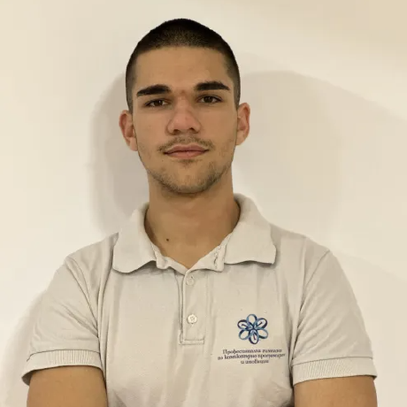
Our team
Daniel kostadinov
Ivelin voynov
Aleksandar lalev
Lychezar Rashkov
DEVOLOPER
DEVOLOPER
DEVOLOPER
SCRUM TRAINER

Slide 3
01
03
Stages of devolopment
02
04
Brainstorm the idea
devolopment
Think about ideas and talk obout them.
Create the game.
Make the design
Presenting
Crating the design.
Presenting in front of judges.

Slide 4









The technology we used

Slide 5
LET’S JUMP TO THE PROJECT!

