Slide 1

GradeUP

Slide 2
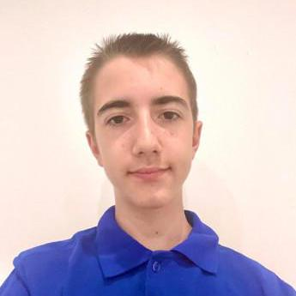
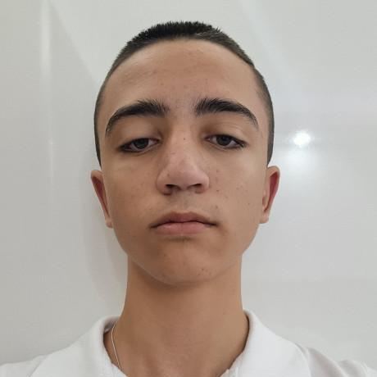
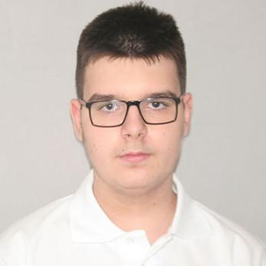
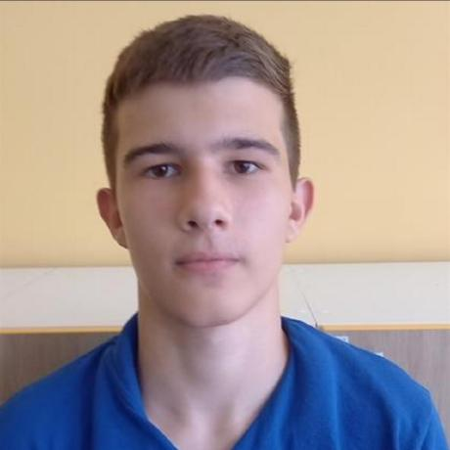
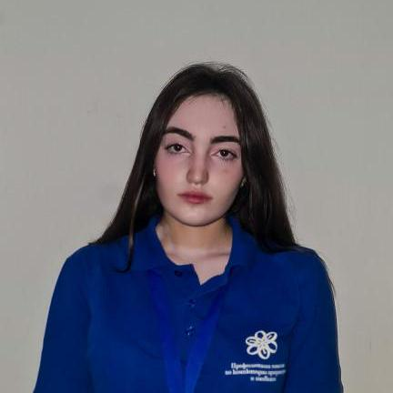
OUR TEAM
Stelian Mikov
Scrum Master
Kevin Rusev
Backend
TODOR IVANOV
Backend
Georgi Filipov
Designer
Polina Dineva
Designer

Slide 3

OUR IDEA
The main idea of the app GradeUP is to help users discover their ideal university path through personalized recommendations. The platform uses AI-powered matching to suggest universities and programs based on the user’s skills, interests, and goals. Users can either take a survey to receive tailored suggestions or explore universities directly.

Slide 4
STAGES OF REALIZATION
Idea and concept
Planning
Development
Launch and Present
Testing and Documentation

Slide 5








Used technologies

Slide 6
LET’S MovE TO THE APP ->

