Slide 1

PATHFINDER
A modern platform for student’s path

Slide 2
Table of contents
01
02
03
04
Our team
Idea
Process
Used technologies

Slide 3
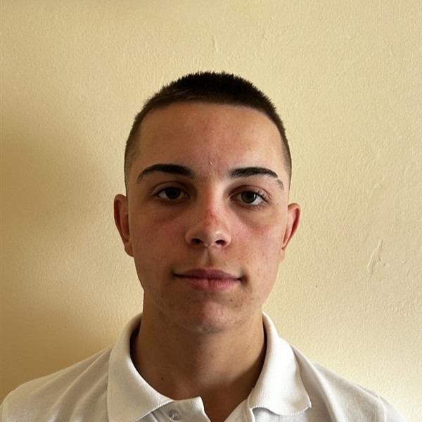
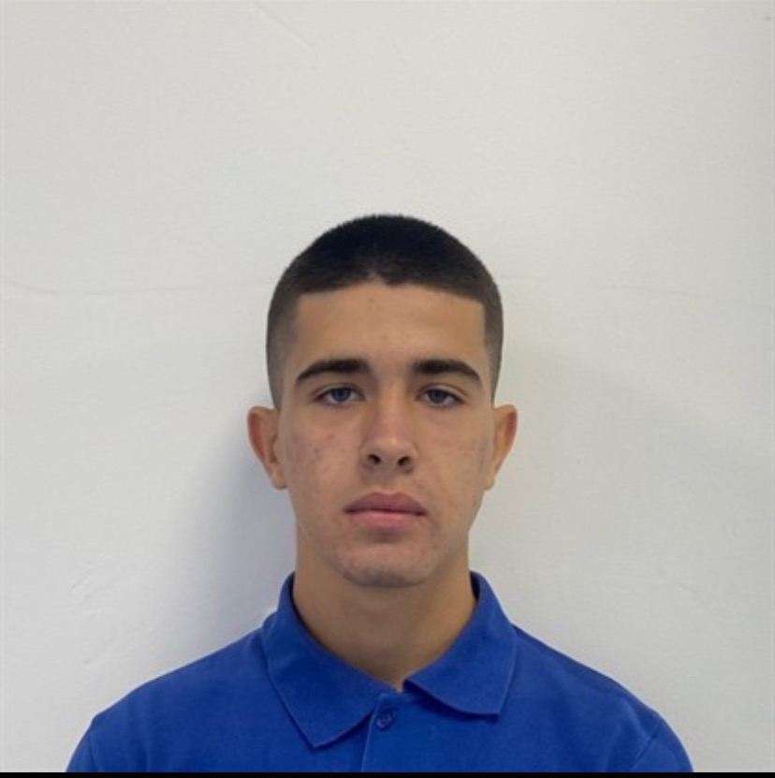
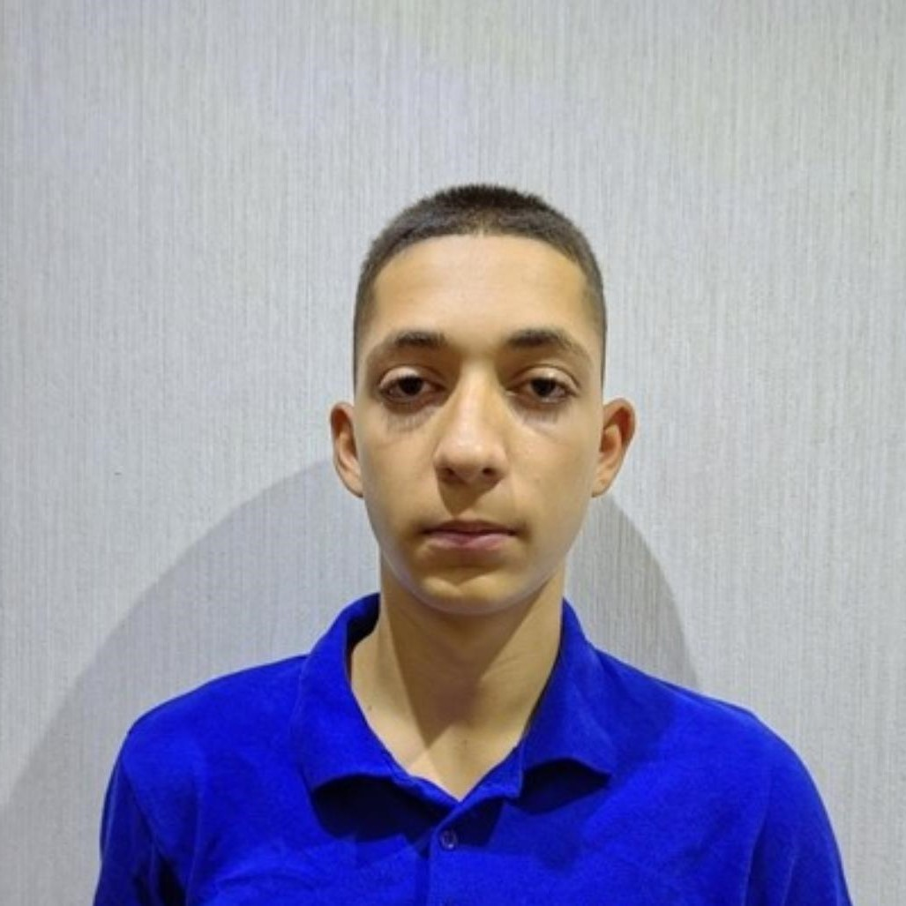


Our team

Slide 4


Idea

Slide 5
Process
Organization
Decide on the idea
Development
Present

Slide 6








Used technologies

Slide 7
Let’s jump into the project

