Slide 1
My path

Slide 2
Table of contents
01
Our team
03
Our project
02
05
Our idea
Used technologies
04
Stages of realization

Slide 3
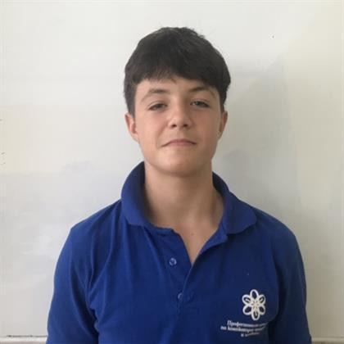
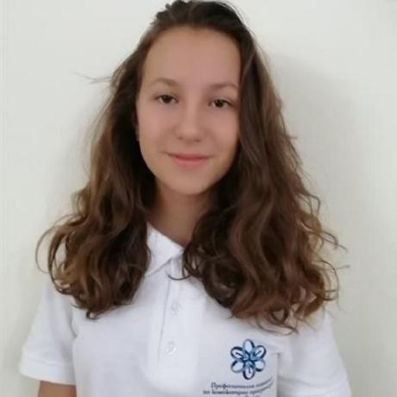
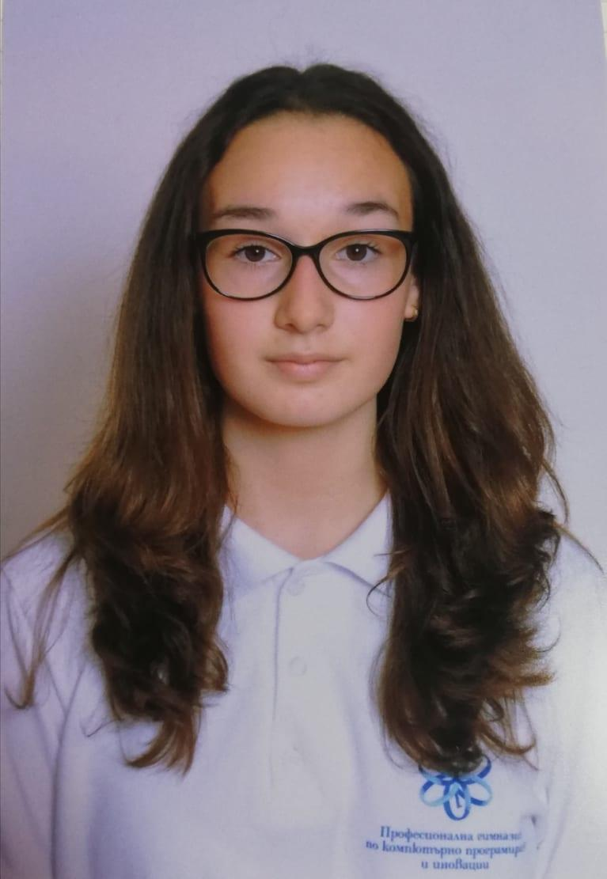
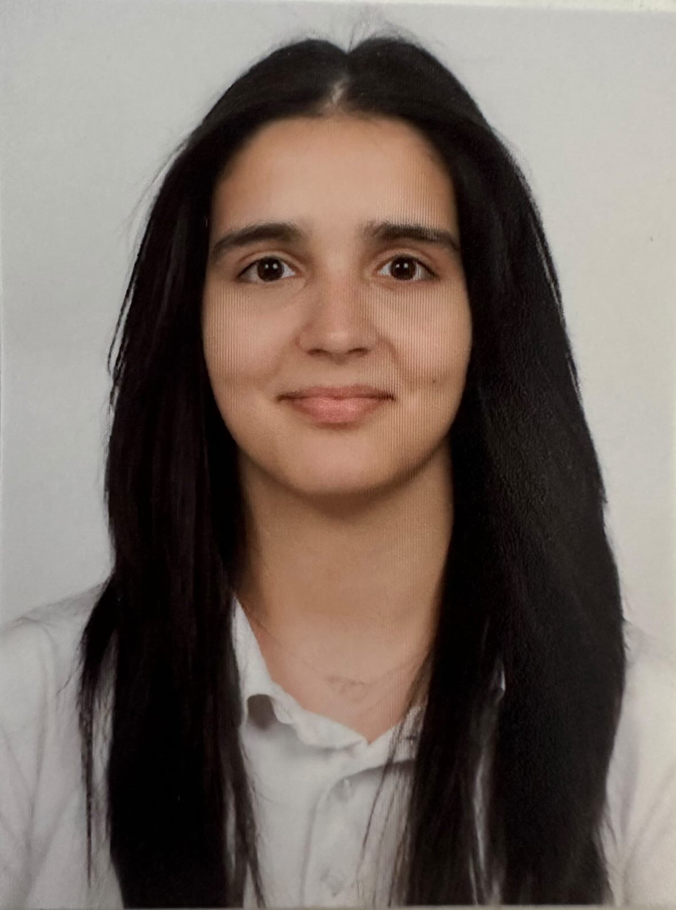
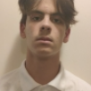
Steliyan Nikolov
Scrum Trainer
Alexandra Zheleva
Developer
Viktoria Kupenova
Developer
Demetra Karagyozova
Designer
Dimitar Dimov
Designer

Slide 4

Our idea
Our idea is to create an application, which will help students to choose the right video to watch based on a particular survey

Slide 5
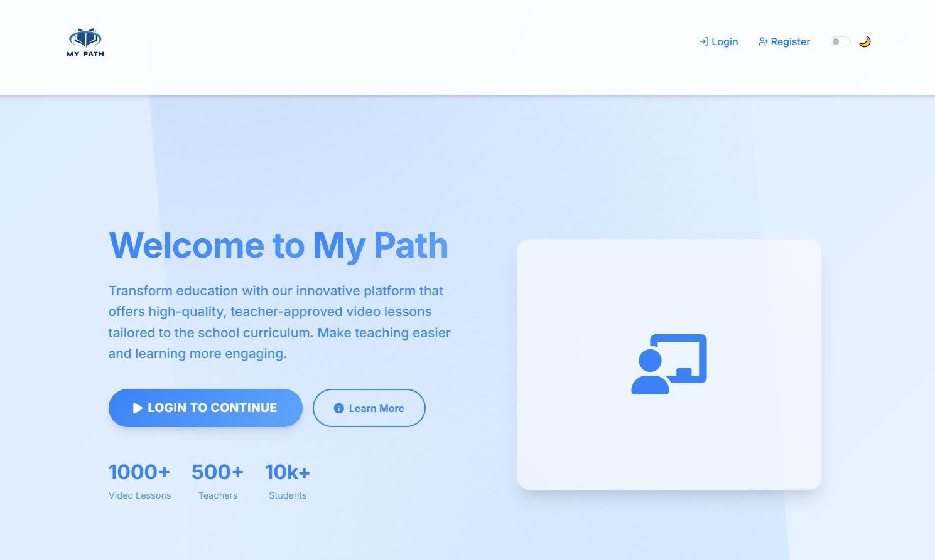
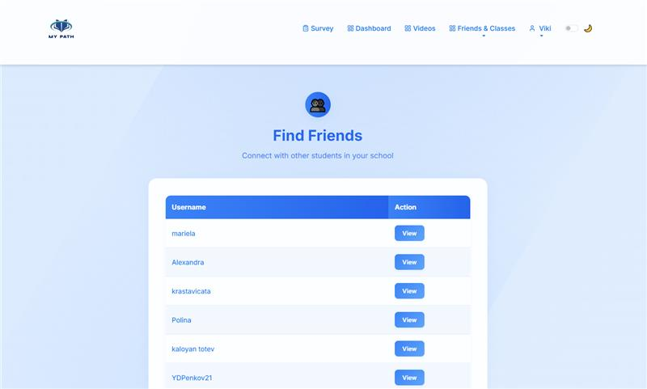
Our project

Slide 6
Beginning
Decisions
Develop
Finalize
Stages of realization
1
2
3
4
Finishing the little details and mistakes on the code
The project is done and ready to be presented
Our team was formed and we started working on the project
Decided about the design and what exactly what our project would be

Slide 7





Used technologies

Slide 8

Thank you for your attention!

Slide 9
Let’s move to the web application!

