Slide 1
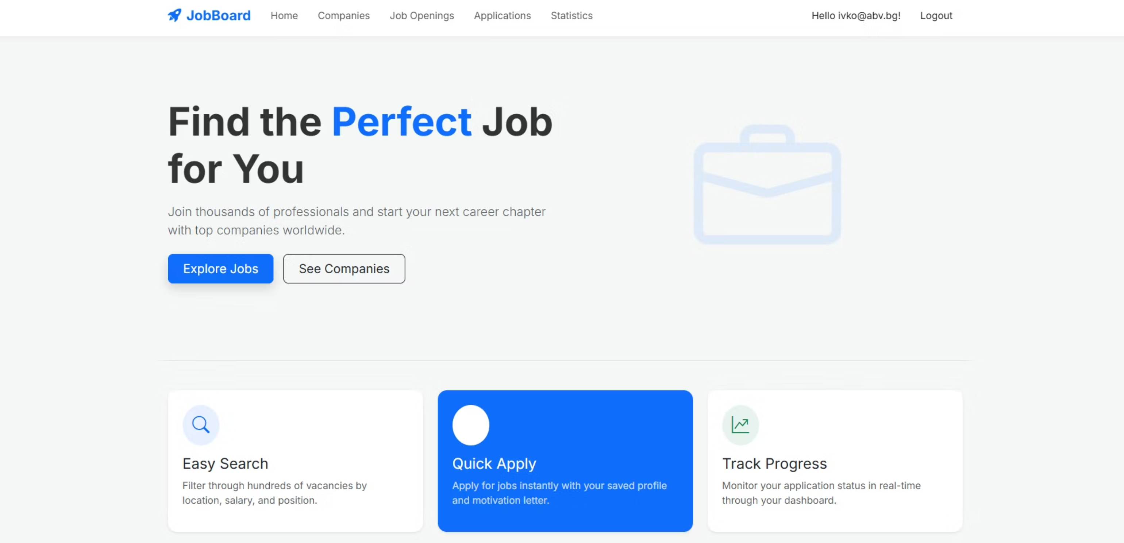
JobBoard Platform
Ivelin Voynov

Slide 2
Project Overview
Goal
Job Management
Company Registration
Connecting employers and job seekers
CRUD operations
Employer accounts
Application System
Real-time Statistics
Job applications
Data analytics

Slide 3
Technical Stack
1
2
Backend
Database
ASP.NET Core 8 MVC
SQL Server & Entity Framework Core
3
4
Security
UI
ASP.NET Core Identity (RBAC)
Bootstrap 5 & Razor Views

Slide 4
Key Technical Solutions
01
02
03
RBAC
Data Integrity
Automation
Admin, Employer, Candidate roles
AsNoTracking() for updates
Database seeding for roles and admin

Slide 5
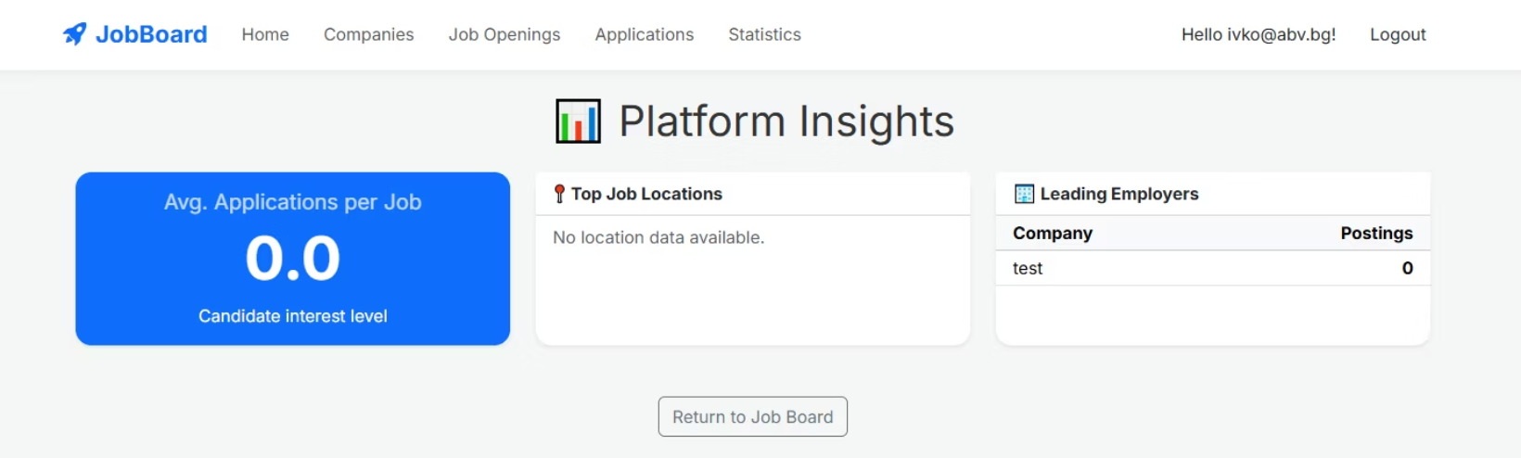
Statistics & LINQ
Analytics
Real-time data aggregation using LINQ
Insights
Automated tracking of jobs, companies, applicants

Slide 6



Future Roadmap
Email Notifications
PDF Resume Upload
Advanced Search
Application alerts
File integration
Location and salary filters

Slide 7

Project Demonstration

