Slide 1


Slide 2

Certa.dev
Cinema platform

Slide 3
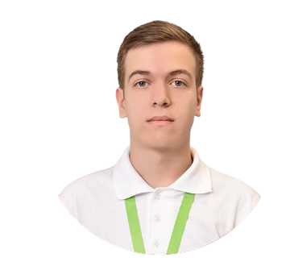


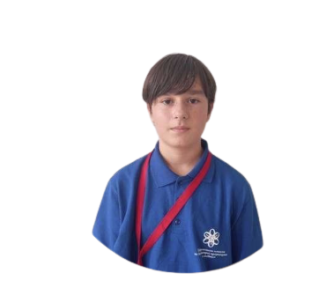
INTRODUCTION
Denislav Dimov
Vsevolod Bolotov
Scrum master
Back-end developer
Georgi Georgiev
Dimitar Rusev
Back-end developer
Front-end developer

Slide 4
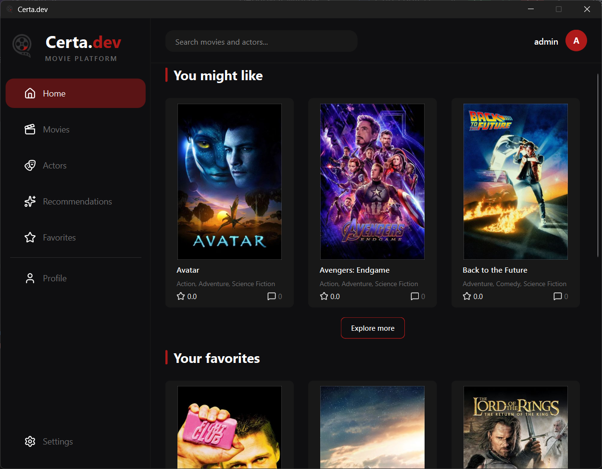
Certa.dev is a desktop application that lets users build a personal movie catalogue, discover new films, and receive recommendations based on their genre preferences. Users can search for movies and view important details such as cast members, ratings, and release dates. The app also helps people organize their collection in one place. By learning what genres each user enjoys, Certa.dev suggests titles they are likely to love, making it easier to find something great to watch.
OUR MISSION

Slide 5







TECH STACK

Slide 6
LET’S START THE DEMO

