Slide 1

Team
Encrypted

Slide 2
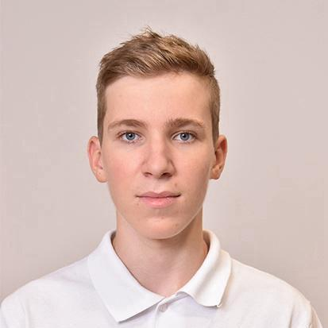

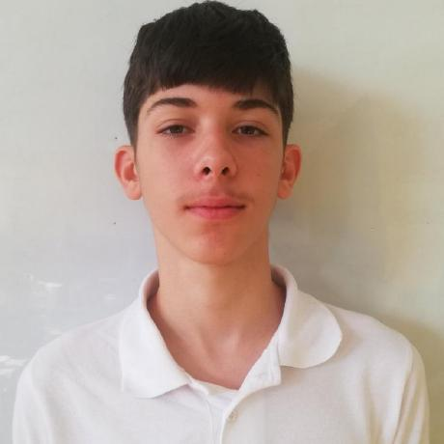
Our team
Maksim Iliev 9V
Iliyan Iliev 9V
Dimitar Yanakiev 9V

Slide 3





Used technologies

Slide 4



Used Languages

Slide 5
Our goal
Create a simple interface for users
Practice teamwork
Create a working maze solver
Write organized code

Slide 6
Let's get to the project!

