Slide 1

💫
FindFriends
Платформа за социализиране
A modern, responsive web application for discovering
and connecting with people.
TABLE OF CONTENTS
01 Technologies Used
05 MapReduce Implementation
02 Contributors
06 Getting Started
03 Project Preview
04 The Idea of the Project

Slide 2
Използвани технологии:
💻
Development
🎨
Design & Assets
▸ Git
▸ Canva
▸ GitHub
▸ Dreamstime (images)
▸ Microsoft Teams
▸ Unsplash (images)
📄
Documentation
🌐
Browser Support
▸ Microsoft Word
▸ Chrome
▸ Microsoft PowerPoint
▸ Firefox
▸ Safari

Slide 3


Екип:
Georgi Gakev
Nikolay Ivanov
Developer
Developer
👥 Together building connections that matter

Slide 4
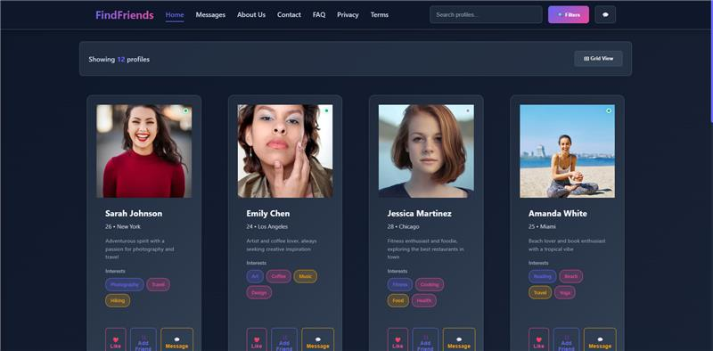
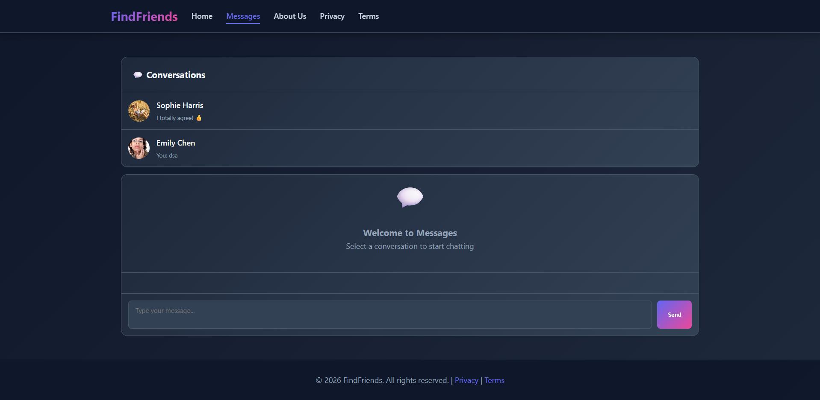
Основен изглед на сайта:
Responsive across all devices:
📱 Mobile
💻 Desktop
📟 Tablet
Built with pure HTML · CSS · JavaScript

Slide 5
Самата идея на проекта
"
Connecting people, creating friendships.
FindFriends is a platform built to make social discovery simple,
modern, and accessible — with no backend required.
🔍
💬
🔐
📱
Discovery
Messaging
Privacy First
Responsive
Browse 12+ profiles with advanced filtering, grid & list views, and real-time search.
Full in-app messaging with conversation management, auto-responses & persistent storage.
Entirely client-side. No APIs, no servers. Data stays in LocalStorage — fully private.
Looks great on every device. Designed with a modern, clean responsive UI.

Slide 6
MapReduce - алгоритъм
const profiles = mapProfilesToObjects(rawUserData);
const stats = calculateProfileStats(profiles);
const matches = filterByInterests(profiles, interests);
🗺️
⚙️
🔍
Map Phase
Process Phase
Reduce / Filter
Raw user data is mapped into structured profile objects with normalized attributes.
Statistics and metadata are calculated across all mapped profile objects.
Profiles are filtered and reduced by interests, returning only the best matches.

Slide 7
Как да го стартираме
⬇️ Download
01
Download or clone the FindFriends project repository to your local machine.
📂 Open
02
Navigate to the project folder and open index.html in your preferred browser.
🚀 Explore
03
Start discovering profiles, sending messages, and using all features right away!
📞 support@FindFriends.com
No installation required · No APIs · No accounts
💫 FindFriends — Connecting people, creating friendships

Slide 8

Нека да преминем към проекта!

