Slide 1

Autodorm

Slide 2

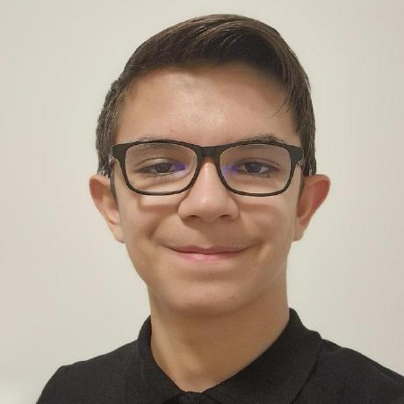
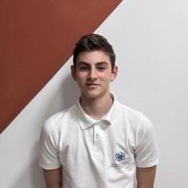


Our team
Antonio Ivov Ivanov Ivan Georgiev Lapchev Beray Guner Nuri Georgi Galinov Gakev Scrum trainer HTML Developer CSS Developer Designer

Slide 3
Mission
AutoDorm is an innovative platform, created with the mission to make choosing a rental car easier. Our platform is aimed at people of all abilities.

Slide 4








Technologies

Slide 5
Demo
Thank you for your attention! Let’s continue with the demo!

