Slide 1

Clutch Cars

Slide 2
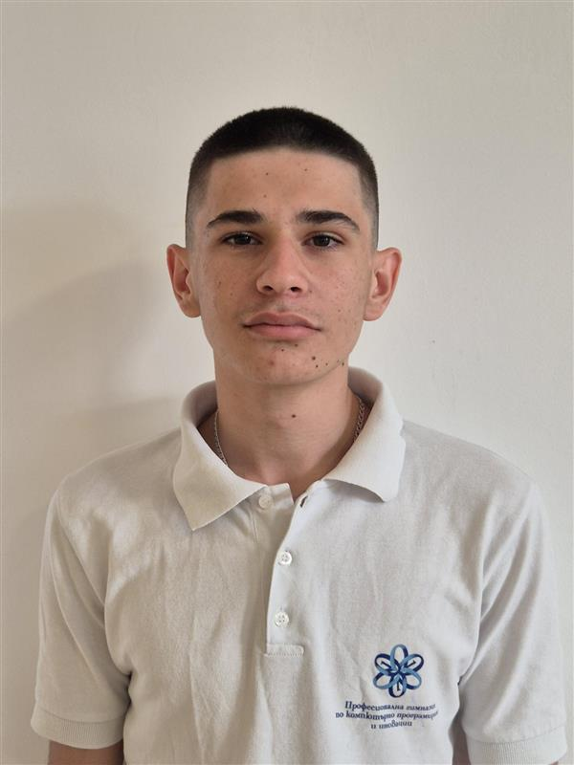




OUR TEAM
Galin Enev
Todor Neshev
Scrum Trainer
HTML developer
Zlati Georgakiev
Maksim Kovcharov
Hristiqn Mihailov
CSS developer
Designer
Designer

Slide 3
Stages
Stage 1
Stage 2
Stage 3
Stage 4
1st week
2nd week
3rd week
4th week
Tasks and achievements completed during this week.
Progress and milestones achieved in this period.
Key activities and outcomes of the week.
Summary of work and results accomplished.

Slide 4







Used Technologies

Slide 5
Let’s get to the app!

