Slide 1
ESPADA-RENTAL
Website

Slide 2
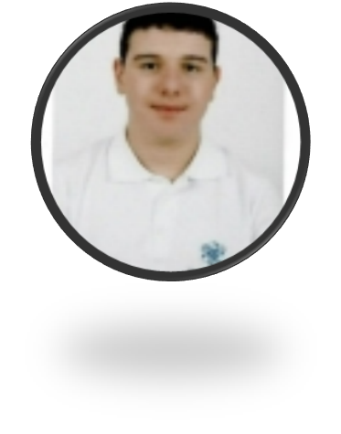



Our team
Iliyan Iliev
Scrum Trainer
Dimitar Bornusuzov
CSS Developer
Svetloslav Dimitrov
Designer
Iordan Rainov
HTML Developer

Slide 3
The idea
This is a website that can be used to rent a car if are in need of one. There are some categories which you can choose from so that you can find the most comfortable and suitable car for your likings.

Slide 4





The apps we used
Visual Studio Code
PowerPoint
Word
GitHub
Teams

Slide 5
How we distributed our time
1. First week - thinking about the theme and the information.
2. Second week – we started writing the codes for all of the pages including the CSS and HTML files.
3. Last week – we made all of the documentation about the website.

Slide 6
NOW LET’S MOVE TO THE DEMONSTRATION

Slide 7
THANKS FOR YOUR
ATTENTION!

