Slide 1
FUSIONEXPRESS

Slide 2
CONTENT
Here’s what you’ll see in our presentation:
1. Our team
2. The purpose of the project
3. Progress
4. Used softwares and programmes
5. Languages used

Slide 3
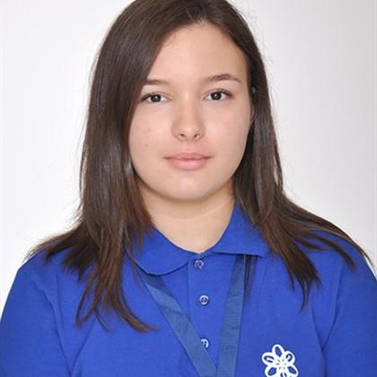
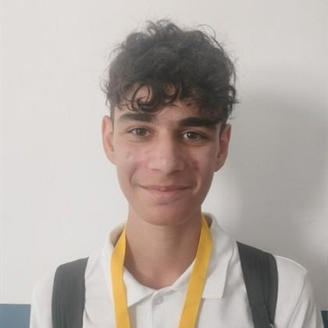
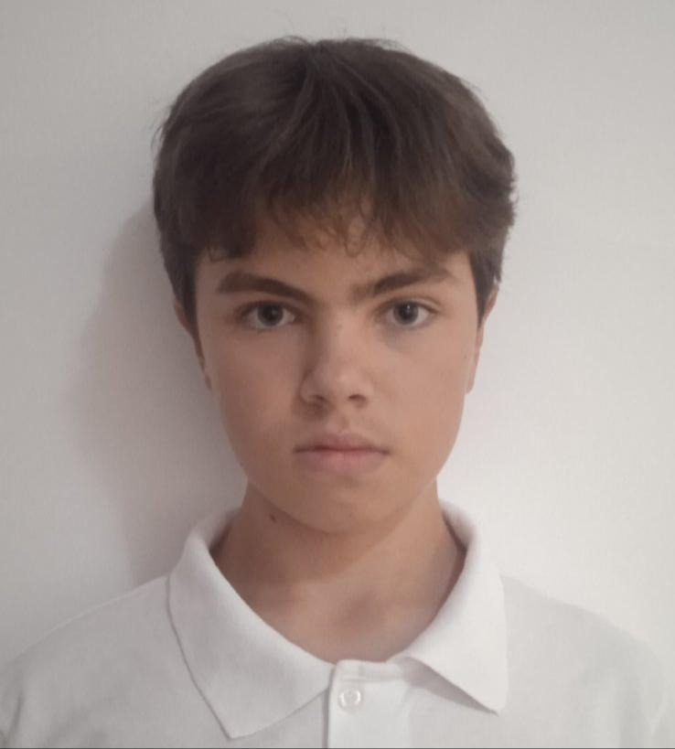
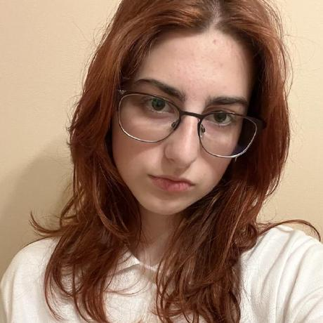
1. Our team
04.
Dimana Foteva 8G
Radostin Dimkirichev 8A
Scrum trainer
Front-end developer
Vsevolod Bolotov 8V
Mariela Apostolova 8B
Front-end developer
Designer

Slide 4
The purpose of the project
1.

Slide 5
2. Project developing
4. Presenting
1. Team assembling
3. Finalization

Slide 6











04.
Used softwares and programmes and languages

Slide 7
Thank you for your attention!
Now let’s move onto the project…

