Slide 1


RentAuto

Slide 2
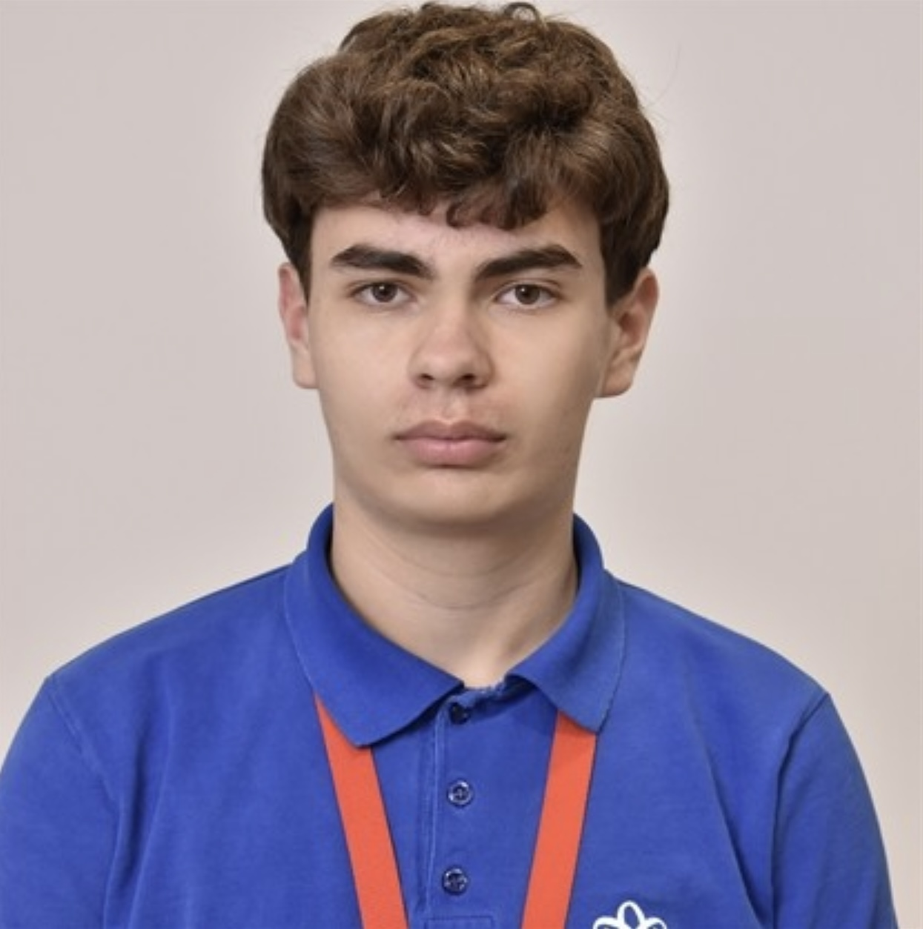

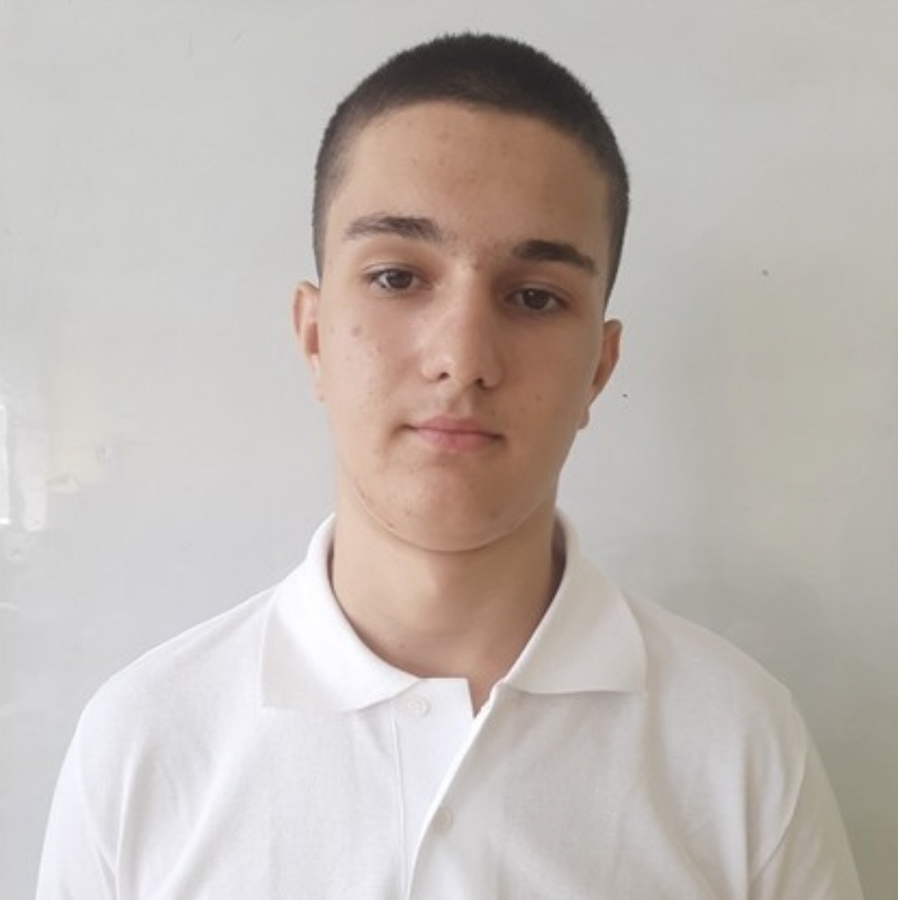
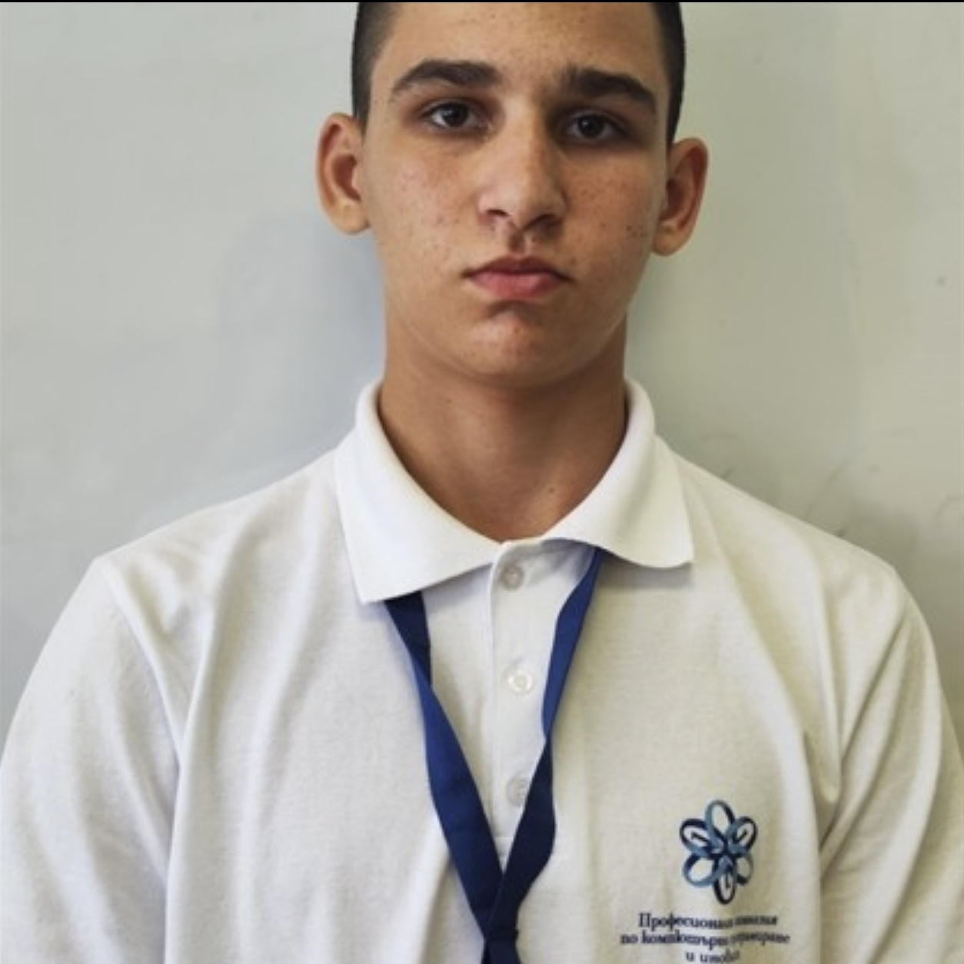
Team members
Ivaylo Georgiev
Toma Ivanov
Marin Marinov
Vladimir Velikov
Scrum Trainer
Front-End Developer
Back-End Developer
Designer

Slide 3
About the project
The idea of the project is to develop a web-based car rental application (website) that provides a convenient, easy-to-use and efficient way for users to browse available cars, check their features and prices, and make online reservations. Through the implementation of this project, skills in web programming, databases, user request processing and dynamic content creation will be demonstrated.

Slide 4
Stages
Stage 1
Stage 2
Stage 3
1st week
2nd week
3rd week
We came up with the idea, created a logo and design.
We added the car pages and created a home page.
We finished the details, made a presentation, documentation and read me.

Slide 5








Used Technologies

Slide 6
Let’s get to the app!

