Slide 1

Road Code
Your Journey Starts Here

Slide 2

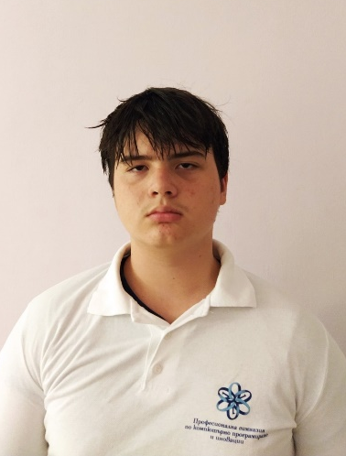
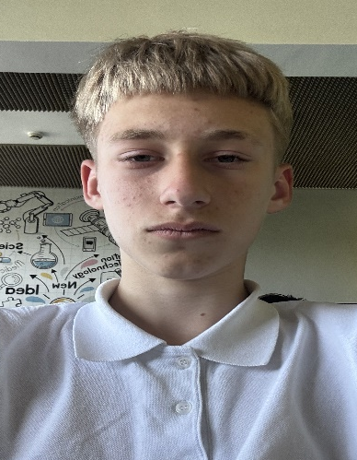
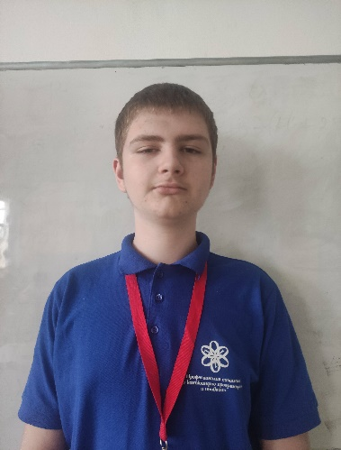
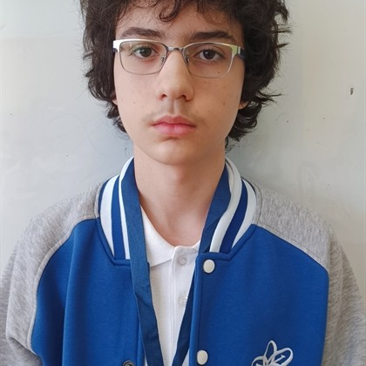
OUR TEAM
Denis Zlatinov Paspalov
Vasilen Zlatinov Gospodinov
Scrum Trainer
HTML Developer
Miroslav Georgiev Iliev
Loris Onik
Zadikqn
CSS Developer
Designer

Slide 3

STAGES
Stage 1
Stage 2
Stage 3
Stage 4
Second half of week 3
First half of week 3
1st week​
2nd week
We assigned everyone's roles and began the project.
We completed the skeleton of the project and began adding details and additional pages.
We were almost done with the project and
we began working on the documentation.
We completed the project and finished the presentation.

Slide 4





Used Technologies

Slide 5
Thank you for your attention, and now, let's head to the site!

