Slide 1




Slide 2
Table of contents
1 Our Idea 2 Our team 3 Used technologies

Slide 3

Hello, we are BLU. With our project, made by using HTML5, CSS and JS we have created a website where you can check and report to local firefighters about dangerous fires in real time by providing details and the exact location on the map. Enjoy! -BLU™

Slide 4
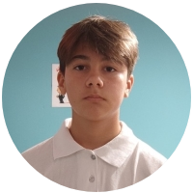
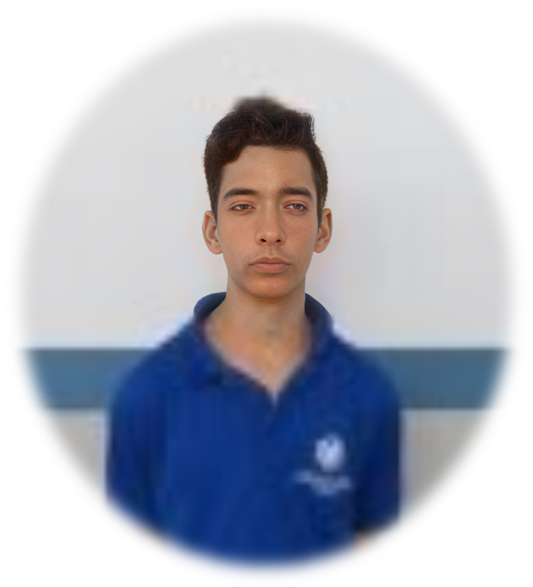

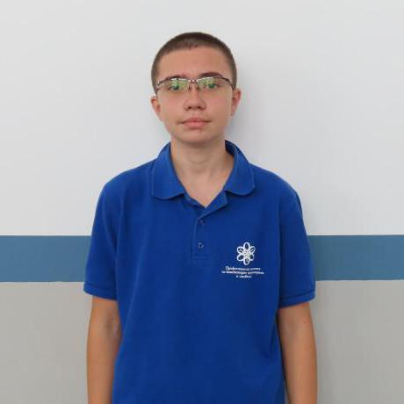
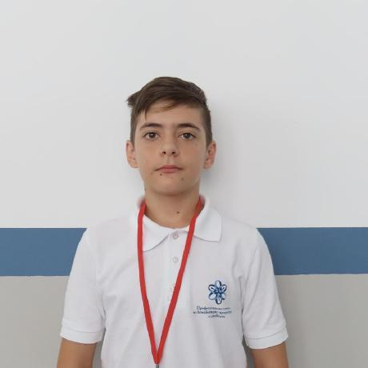
Our Team
Scrum Trainer
Petar Dimitrov 9G
Front-end Developer
Back-end developer
Designer

Slide 5
Our Team
Front-end Developer
Rumen Spasov 9V
Scrum Trainer
Back-end developer
Designer

Slide 6
Our Team
Back-end developer
Presiyan Kolev 9A
Scrum Trainer
Front-end Developer
Designer

Slide 7
Our Team
Designer
Martin Yanev 9B
Scrum Trainer
Front-end Developer
Back-end developer

Slide 8










Tools we have used

Slide 9
Now let’s proceed to the project

