Slide 1
Bug Busters

Slide 2
Table of contents
01
02
03
Our Team
Idea
Process & Technologies

Slide 3
Our Team

Slide 4
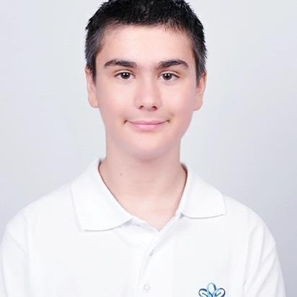
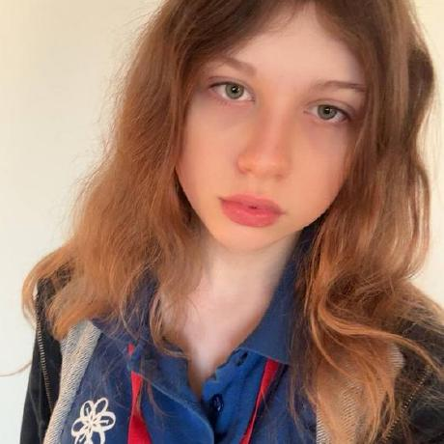
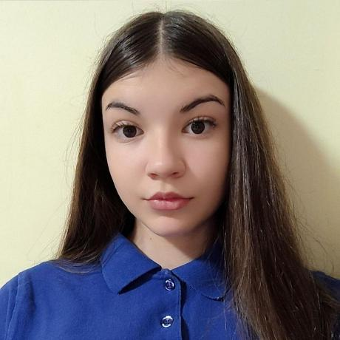
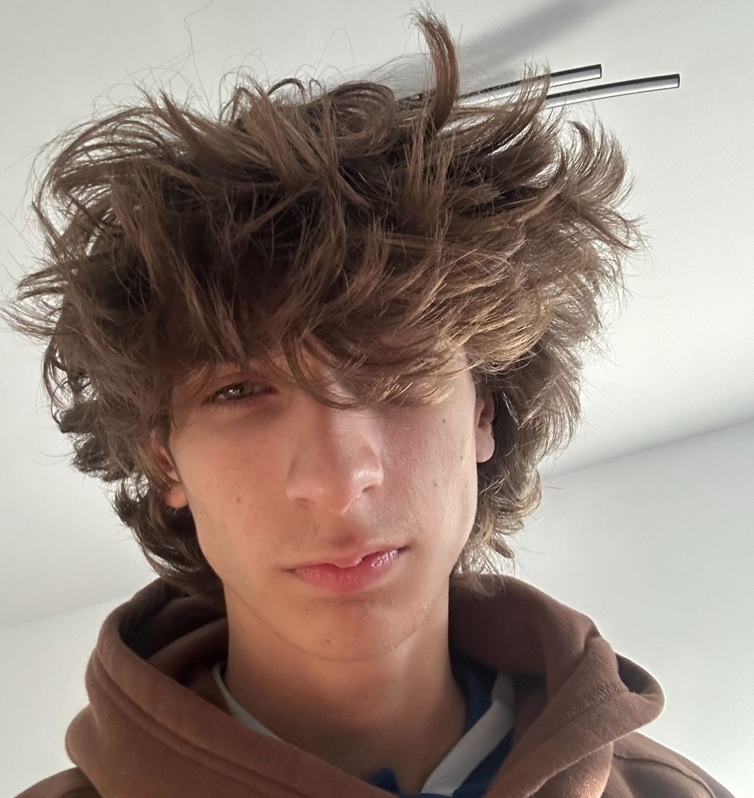
Team
Кристиян Парашкевов 9Г – Front end Developer
Лея Сусова 9Б – Back end Developer
Росица Парапанова 9В – Scrum Trainer
Любомир Куманов 9Г - Designer

Slide 5
02 Idea

Slide 6
IDEA
Here in Bug Busters, our mission is to create an easy to use website where you can request a rescue team to your desired location, report a fire incident and other fire related problems.

Slide 7
Process and Used Technologies

Slide 8





Process and Used Technologies
MS Teams
Visual studio code
MS
Powerpoint
Github
MS Word

Slide 9
LET’S GO ON WITH OUR PROJECT

