Slide 1
class Presentation {
forbeginners.html
workshop.js
public:
string Team_Name = Code Core;
}
Programming Language: C++

Slide 2
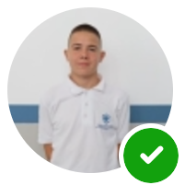
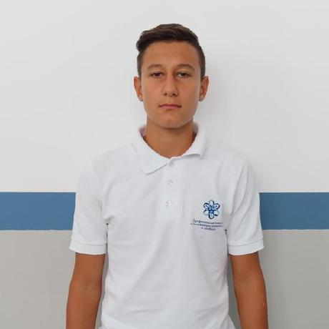

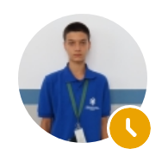
class Our_Members2 {
forbeginners.html
workshop.js
Designer: Teodor Enev
Back-end developer: Nedelin Manolov
Front-end developer: Aliks Abdula
Scrum Trainer: Kristian Andreev
}
Programming Language: C++

Slide 3





var Used_apps = {
forbeginners.html
workshop.js
Teams: for communication
Visual Studio 2022: for writing code
PowerPoint / Word:
for presentation and documentation
GitHub: for submitting out work
}
Programming Language: C++

Slide 4
alert(“What we want to avchieve: “);
forbeginners.html
workshop.js
What we’ve tried to achieve is create an early version of a site with the intent of educating people about what to do in case of a fire emergency, as well as allowing them to report and incidents.
Programming Language: C++

Slide 5

function review(){
workshop.js
forbeginners.html
alert(“Let’s review our site now”);
}
< Please keep this slide for attribution >
Programming Language: C++

