Slide 1
DataVision

Slide 2
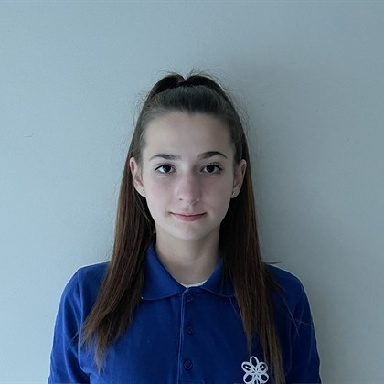
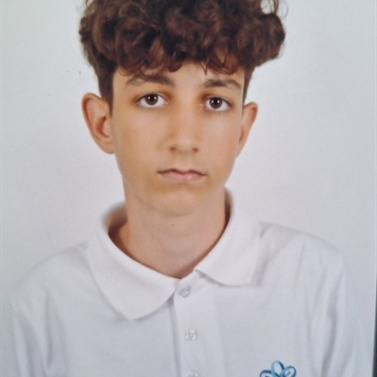
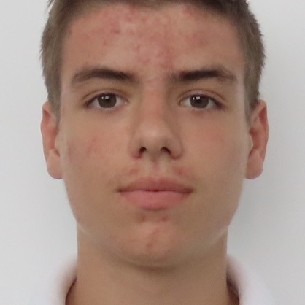
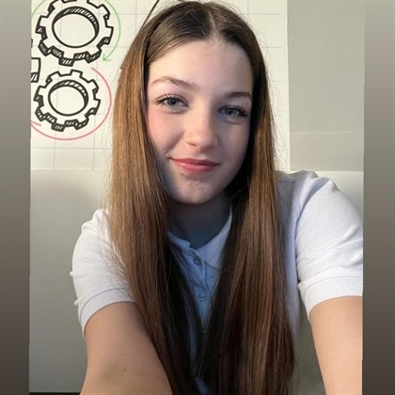
Our Team
Gabriela Badalova
Bojidar Stoyanov
Scrum Trainer 9b
Back-end Developer 9g
Mihail Conkov
Emanuela Mancheva
Front-end Developer 9v
Designer 9a

Slide 3
Stages
01
02
03
Choose idea
Start realising our idea
Make the webpage
04
05
06
Make design
Fix our webpage
Make documentation

Slide 4








Used programs

Slide 5
Let’s go to our webpage

