Slide 1

Presentation

Slide 2
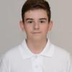
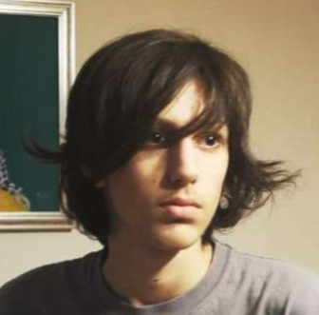
Our members:
Mihail Karanikolov
9G
Scrum Trainer, Frontend Developer
Damyan Kerchev
9A
Backend Developer, Designer

Slide 3






Used Technologies/Apps
GitHub for submitting out work
Visual Studio Code to make make the project
PowerPoint & Word for Presentation & Documentation
Discord & Microsoft Teams for communication

Slide 4
Our Idea & Goal:
A platform where people can report real-time incidents like wildfires, floods, or accidents, and also access expert-vetted safety articles to stay informed and prepared during emergencies.
Learning how to respond effectively to dangerous situations.

Slide 5

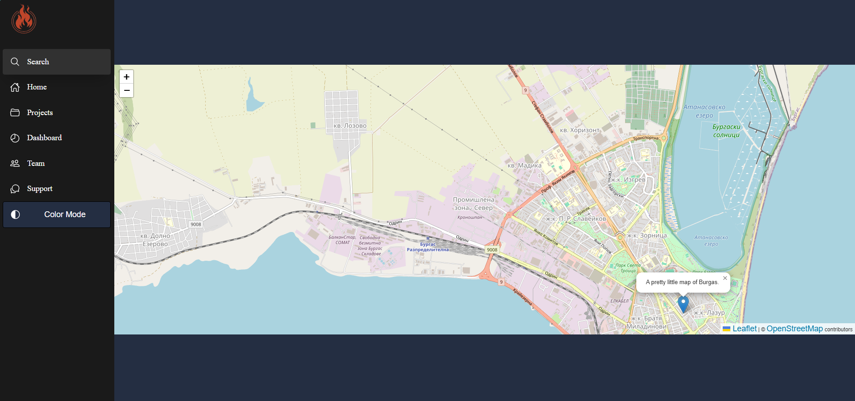
Early Concept

Slide 6

Let's move on to our project!

