Slide 1

Prime Fixture
Here to make our future safe

Slide 2
Table of contents
1. Prime Fixture’s Team 2. The Project of Prime Fixture 3.Used technologies
01. Our team and what you should know about us

Slide 3
01. Our team and what you should know about us

Slide 4
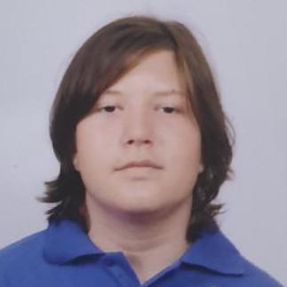
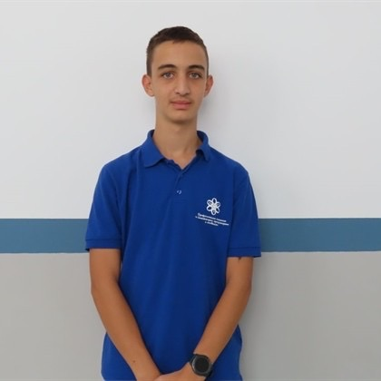
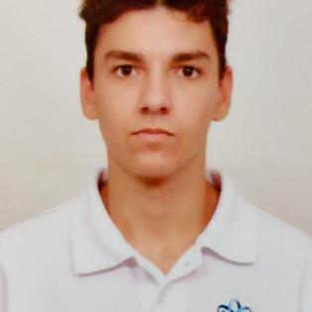
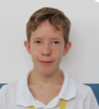
Team Prime Fixture
Georgi Pavlov
Lyubomir Iliev
Scrum trainer
Front-end developer
Kaloyan Boychev
Viktor Nikov
Back-end developer
Designer

Slide 5
02. Our project and the idea behind it

Slide 6
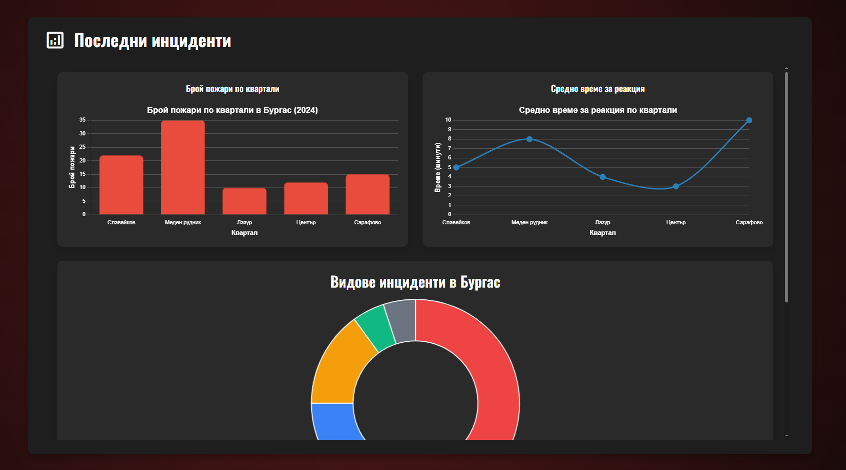
Creation and the idea behind the project
Our project dedicated software designed to support the organization and efficiency of firefighting teams. Developed by Prime Fixture, the platform aims to provide real-time management of personnel, schedules, and critical operations. Built with a focus on reliability and clarity, it simulates the structure of a professional emergency response tool while being developed within an academic environment.

Slide 7










03. Used technologies

Slide 8

03. Used technologies

Slide 9
TO THE PROJECT!

