Slide 1
Team STYLECREATORS

Slide 2
Contents
About Us
Our Idea
Technologies
Stages
Demo

Slide 3
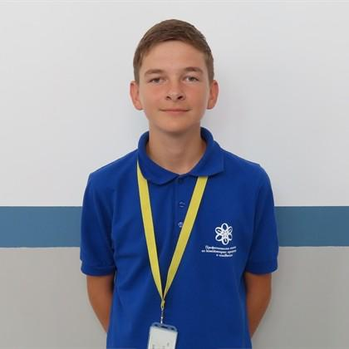
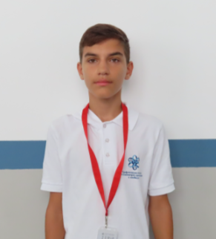
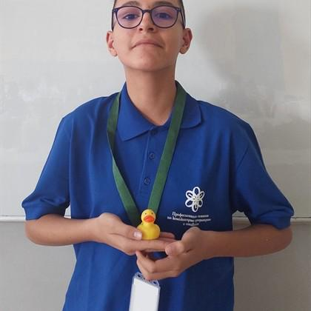
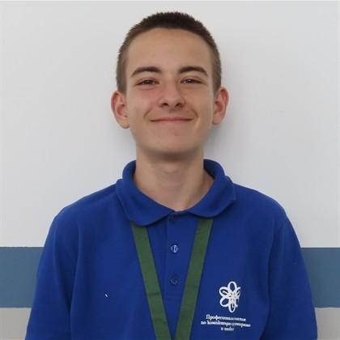
About Us
Emanuil Tinchev
Frontend
developer
Kristiyan Daradjanov
Scrum Trainer
George Yankov
Backend
developer
Stoyan Vasilev
Designer

Slide 4
Contents
About Us
Our Idea
Stages
Technologies
Demo

Slide 5
Our idea
Our website is designed to raise awareness about fires and emergency situations.
It helps people learn more about fire safety, the role of fire department crews, and how to locate the nearest fires in their location.

Slide 6
Contents
About Us
Our Idea
Stages
Technologies
Demo

Slide 7
Stages
1
2
3
4
ORGANISATION​
DECIDE THE IDEA​
DEVELOPMENT
DOCUMENTATION

Slide 8
Contents
About Us
Our Idea
Stages
Technologies
Demo

Slide 9





Technologies

Slide 10
Contents
About Us
Our Idea
Stages
Technologies
Demo

Slide 11
Now let’s check out our site!

