Slide 1
TEAM Z
ET ON FIRE

Slide 2
TABLE OF CONTENTS
01
02
03
OUR TEAM
IDEA
PROCESS &
TECHNLOGIES

Slide 3
01
OUR TEAM

Slide 4
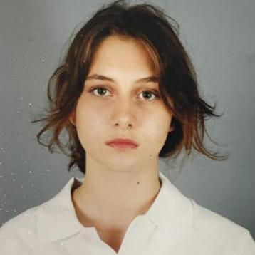
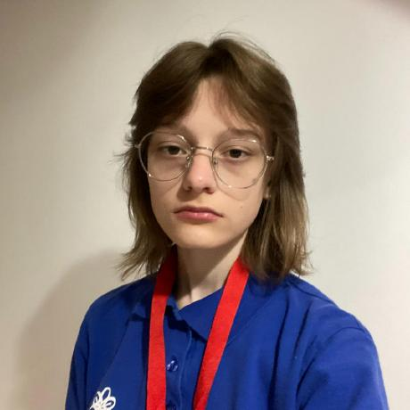
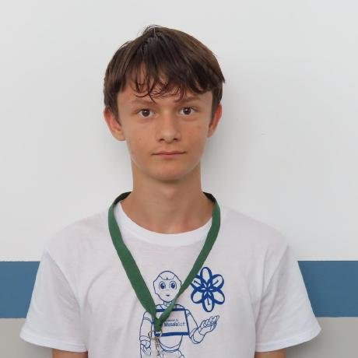
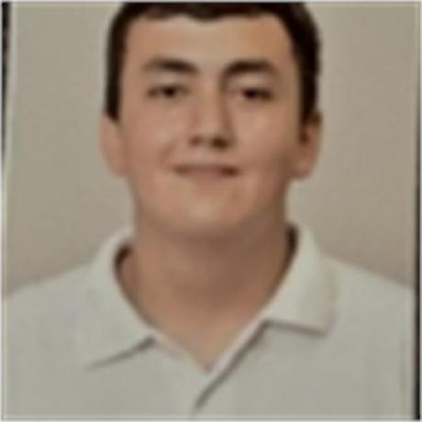
TEAM
Ivayla Keserdzhieva
Back-End Developer
Ekaterina Zalinskaya
Designer
Ivelin Metodiev
Front-End Developer
David Papazyan
Scrum trainer

Slide 5
02 IDEA

Slide 6
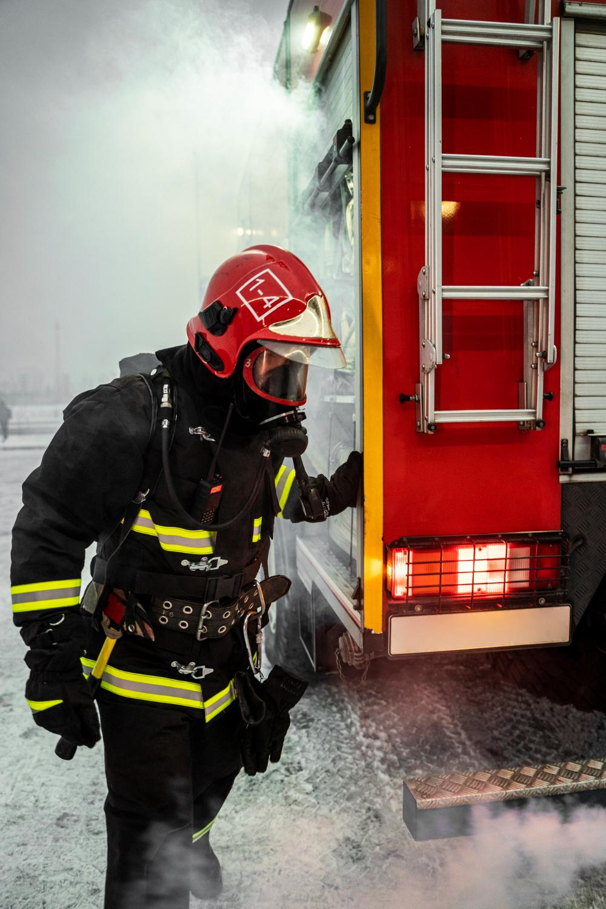
IDEA
We are Team Z(et on Fire), and our mission is to create a website where you can report fire incidents happening in your area. Our platform is designed to make filling out the form easy for everyone. Additionally, we provide access to our team information and charts.

Slide 7
PROCESS & USED TECHNOLOGIES

Slide 8








PROCESS & USED TECHNOLOGIES
1-4 Weeks
1-4 Weeks
4 Week
1-4 Weeks
4 Week
1-3 Weeks
1-4 Weeks
1-4 Weeks

Slide 9
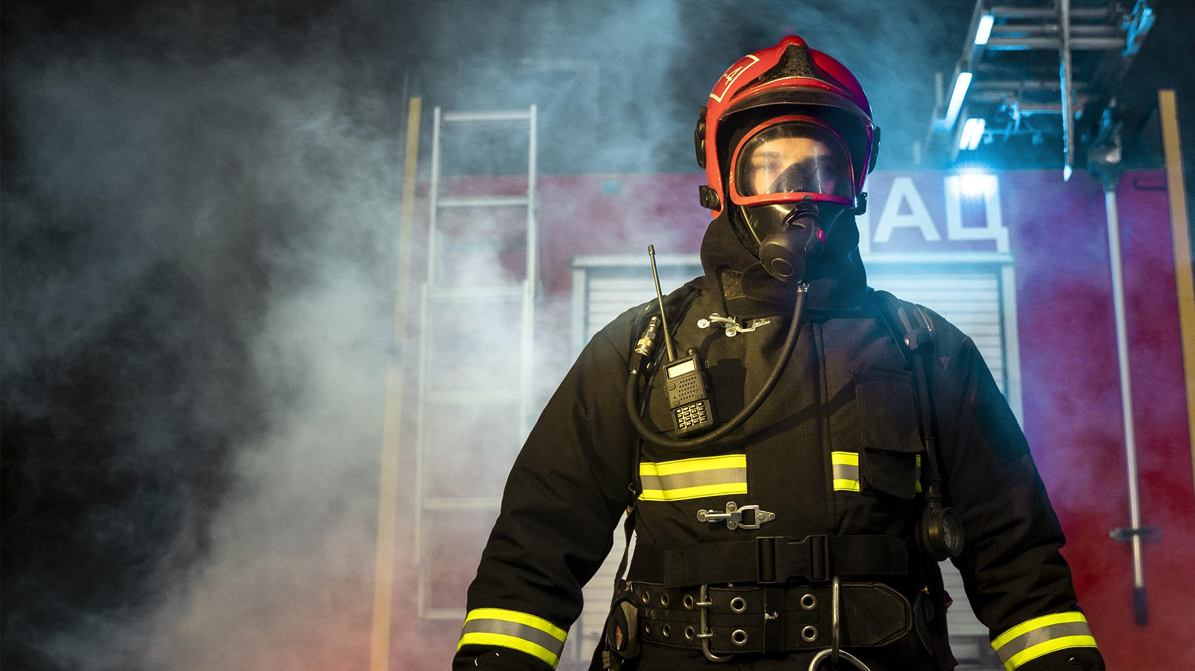
LET’S CONTINUE TO OUR PROJECT

