Slide 1
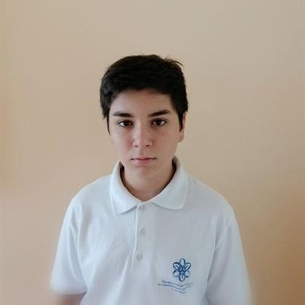

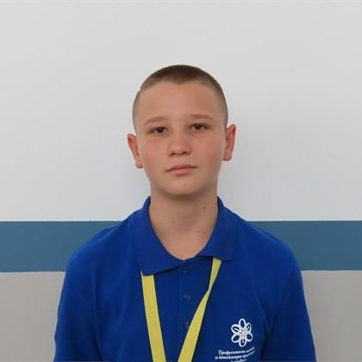
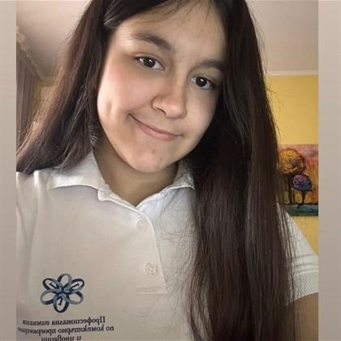

Мартин Димаров
Frontend developer
Улвие Мустафа
Scrum trainer
Георги Лицановски
Designer
Шениз Али
Backend Developer
By Troya studios
Project
Technologies
Our Site
Realization
Team
Home
TroyaOnFire
Stay Safe, Stay Connected

Slide 2
Stage 1
Stage 2
Stage 3
Add backend
Make the documentation
Create frontend
Create design
By Troya studios
Project
Technologies
Our Site
Realization
Team
Home
TroyaOnFire
Stay Safe, Stay Connected
Шениз Али
Георги Лицановски
Улвие Мустафа
Мартин Димаров
Backend Developer
Designer
Scrum trainer
Frontend developer

Slide 3






Everything You Need for Fire Safety
Our platform brings together firefighters, safety experts, and community members to create a safer environment for everyone.
Interactive Fire Map
Real-time fire incident reporting and tracking with community-driven updates.
Emergency Alerts
Receive instant notifications about fire incidents and safety warnings in your area.
Community Posts
Share safety tips, event announcements, and success stories with your local community.
Safety Resources
Share safety tips, event announcements, and success stories with your local community.
Regional Focus
Get location-specific information and connect with your local fire department.
Expert Network
Connect with certified firefighters and safety professionals in your region.
By Troya studios
Project
Technologies
Our Site
Realization
Team
Home
TroyaOnFire
Stay Safe, Stay Connected
Stage 1
Stage 2
Stage 3
Create design
Create frontend
Add backend
Make the documentation
Шениз Али
Backend Developer
Георги Лицановски
Designer
Улвие Мустафа
Scrum trainer
Мартин Димаров
Frontend developer

Slide 4










By Troya studios
Project
Technologies
Our Site
Realization
Team
Home
TroyaOnFire
Everything You Need for Fire Safety
Stay Safe, Stay Connected
Our platform brings together firefighters, safety experts, and community members to create a safer environment for everyone.
Interactive Fire Map
Community Posts
Emergency Alerts
Real-time fire incident reporting and tracking with community-driven updates.
Share safety tips, event announcements, and success stories with your local community.
Receive instant notifications about fire incidents and safety warnings in your area.
Safety Resources
Expert Network
Regional Focus
Share safety tips, event announcements, and success stories with your local community.
Connect with certified firefighters and safety professionals in your region.
Get location-specific information and connect with your local fire department.
Stage 1
Stage 2
Stage 3
Create design
Create frontend
Add backend
Make the documentation

Slide 5
By Troya studios
Project
Technologies
Our Site
Realization
Team
Home
TroyaOnFire
Stay Safe, Stay Connected
Everything You Need for Fire Safety
Our platform brings together firefighters, safety experts, and community members to create a safer environment for everyone.
Interactive Fire Map
Community Posts
Emergency Alerts
Real-time fire incident reporting and tracking with community-driven updates.
Share safety tips, event announcements, and success stories with your local community.
Receive instant notifications about fire incidents and safety warnings in your area.
Safety Resources
Expert Network
Regional Focus
Share safety tips, event announcements, and success stories with your local community.
Connect with certified firefighters and safety professionals in your region.
Get location-specific information and connect with your local fire department.

Slide 6
By Troya studios
Project
Technologies
Our Site
Realization
Team
Home
TroyaOnFire
Stay Safe, Stay Connected
Let’s review our project

