Slide 1


Team Unity

Slide 2

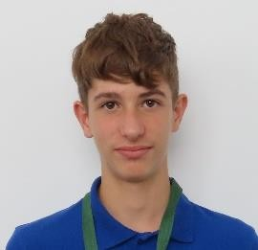
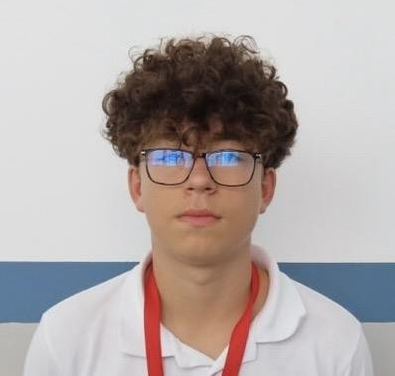
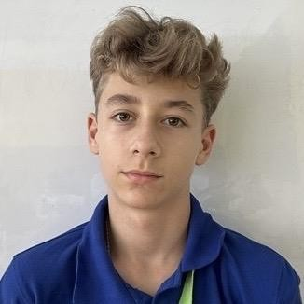
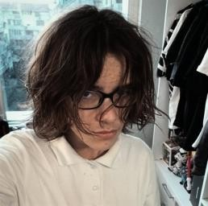
OUR TEAM
Pavel Plamenov Parvanov
Back-end Developer
Aleksandr Sergeevich Toder
Designer
Persiqn Atanasov Tanchev
Front-end Developer
Desislav Dimitrov Aleksandrov
Scrum Trainer

Slide 3
ABOUT OUR IDEA
The idea for our site is to help all the fire fighters and citizens. It can be used to review fire centers in the region of Sofia. Also you can send an alert for a fire nearby you. You can also see all the fires occurring at the moment.

Slide 4

STAGES
Stage 1
Stage 2
Stage 3
1st week
2st week
3st week
We were thinking about our logo and site.
We were organized meetings and we started working on the project.
We finished the project and made a presentation and documentation.

Slide 5








USED TECHNOLOGIES

Slide 6
AND NOW LET’S
MOVE TO OUR SITE!

