Slide 1
VisionAngels
Protecting Communities Through Early Fire Detection

Slide 2
TABLE OF CONTENTS
01
02
03
04
Our Team
About Our Idea
Work Progress
Programs We Used

Slide 3
01
Our Team

Slide 4
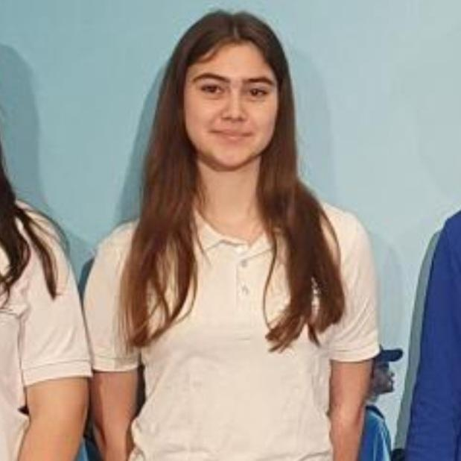
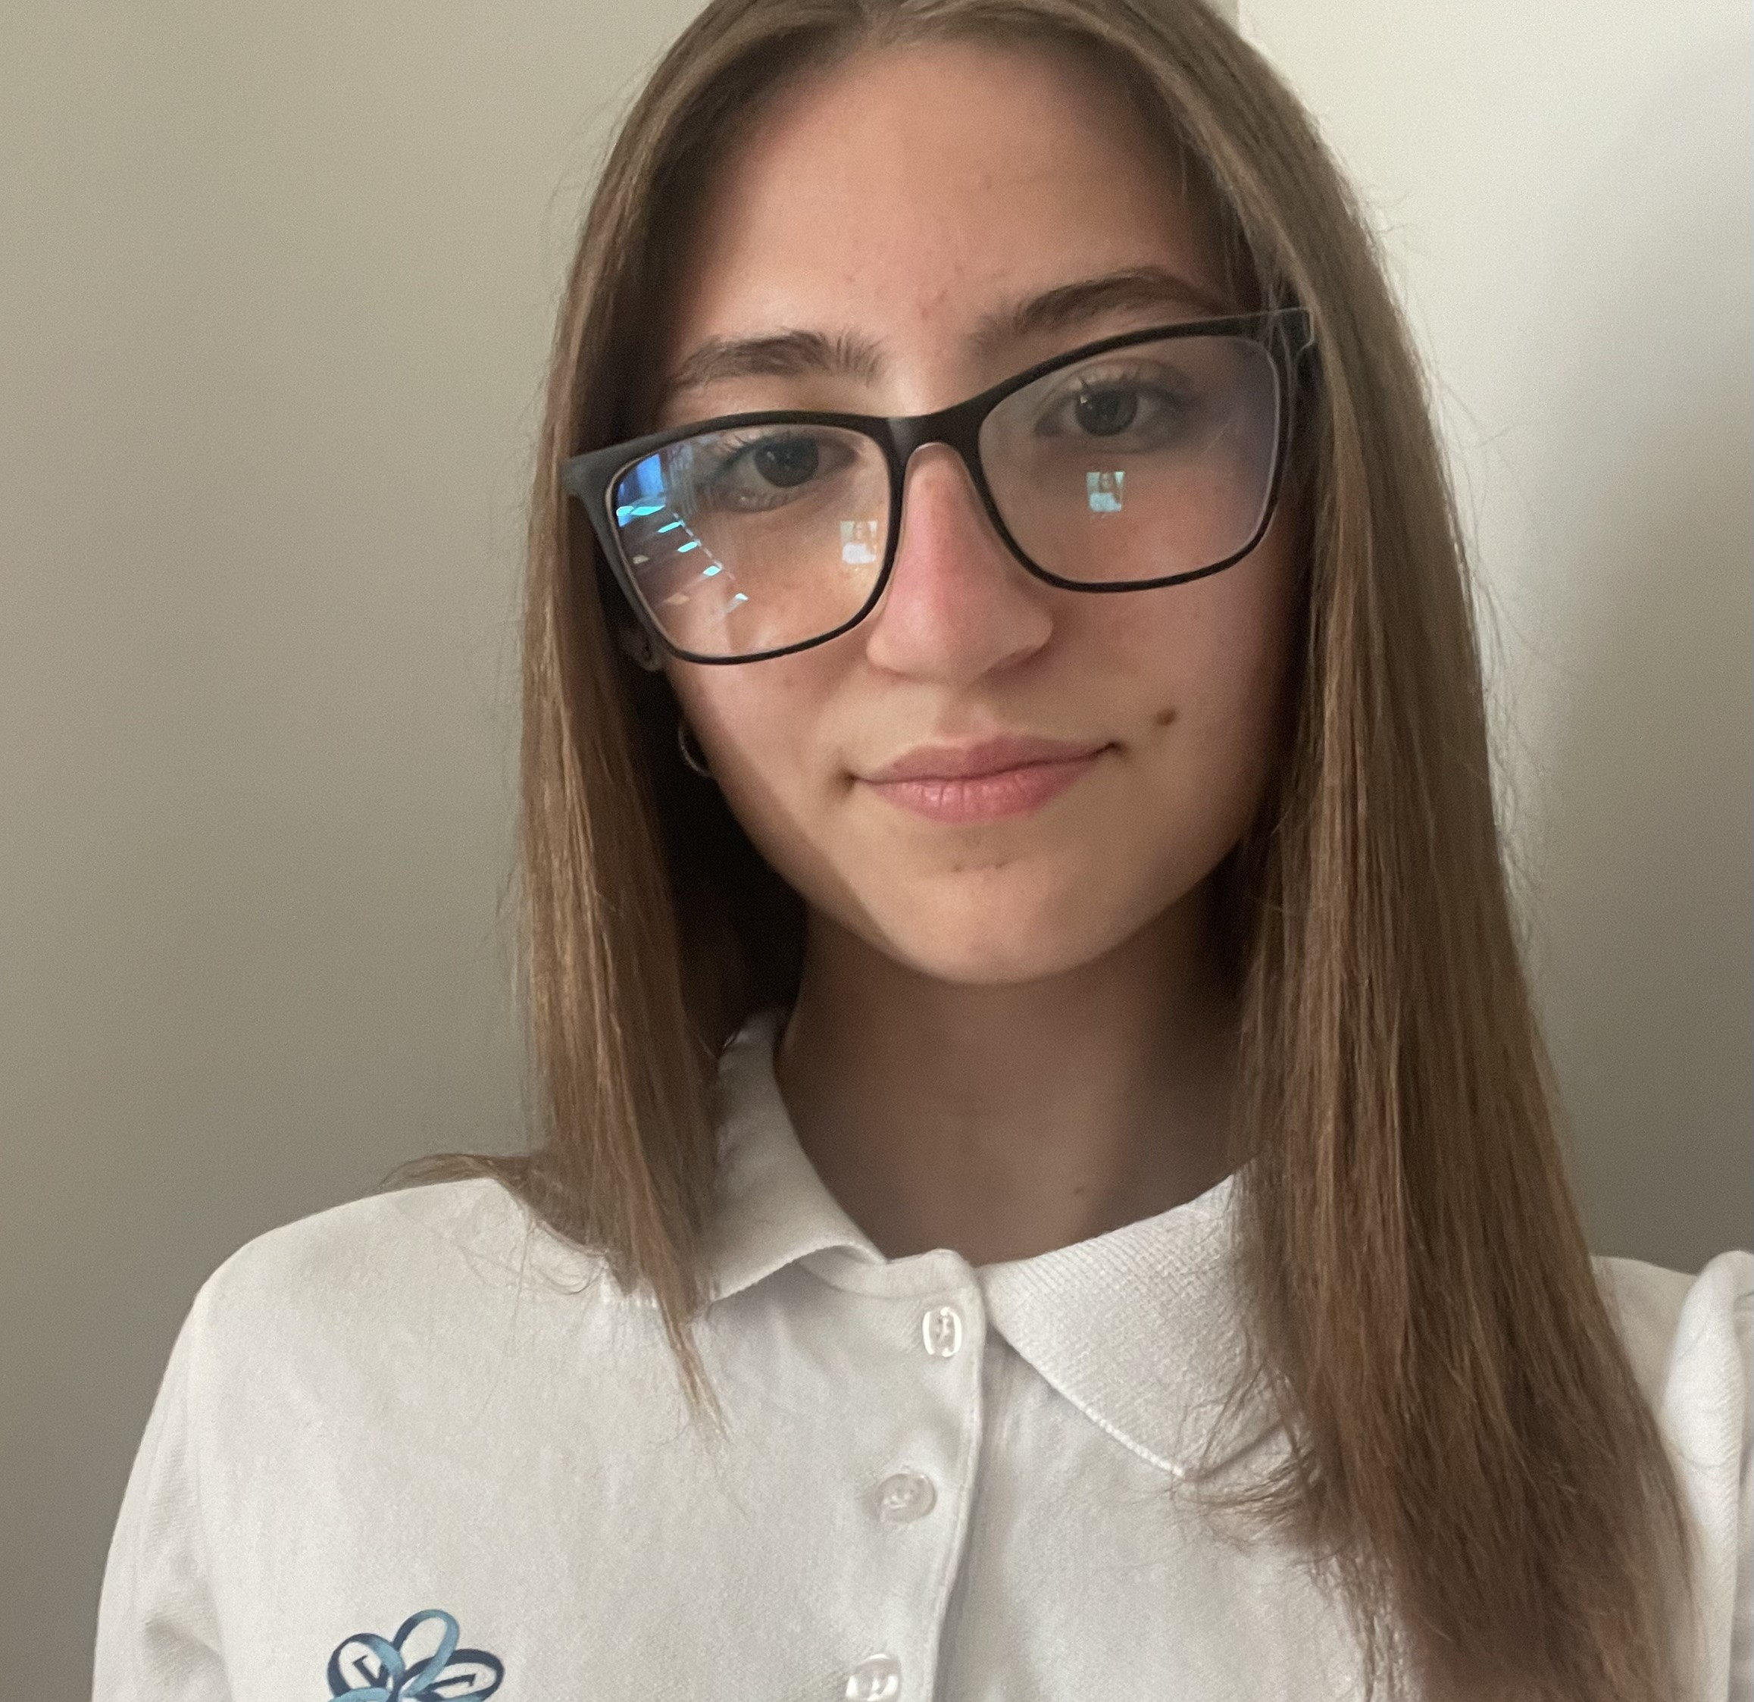
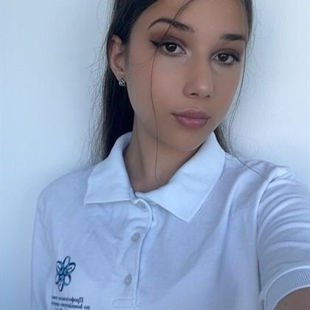
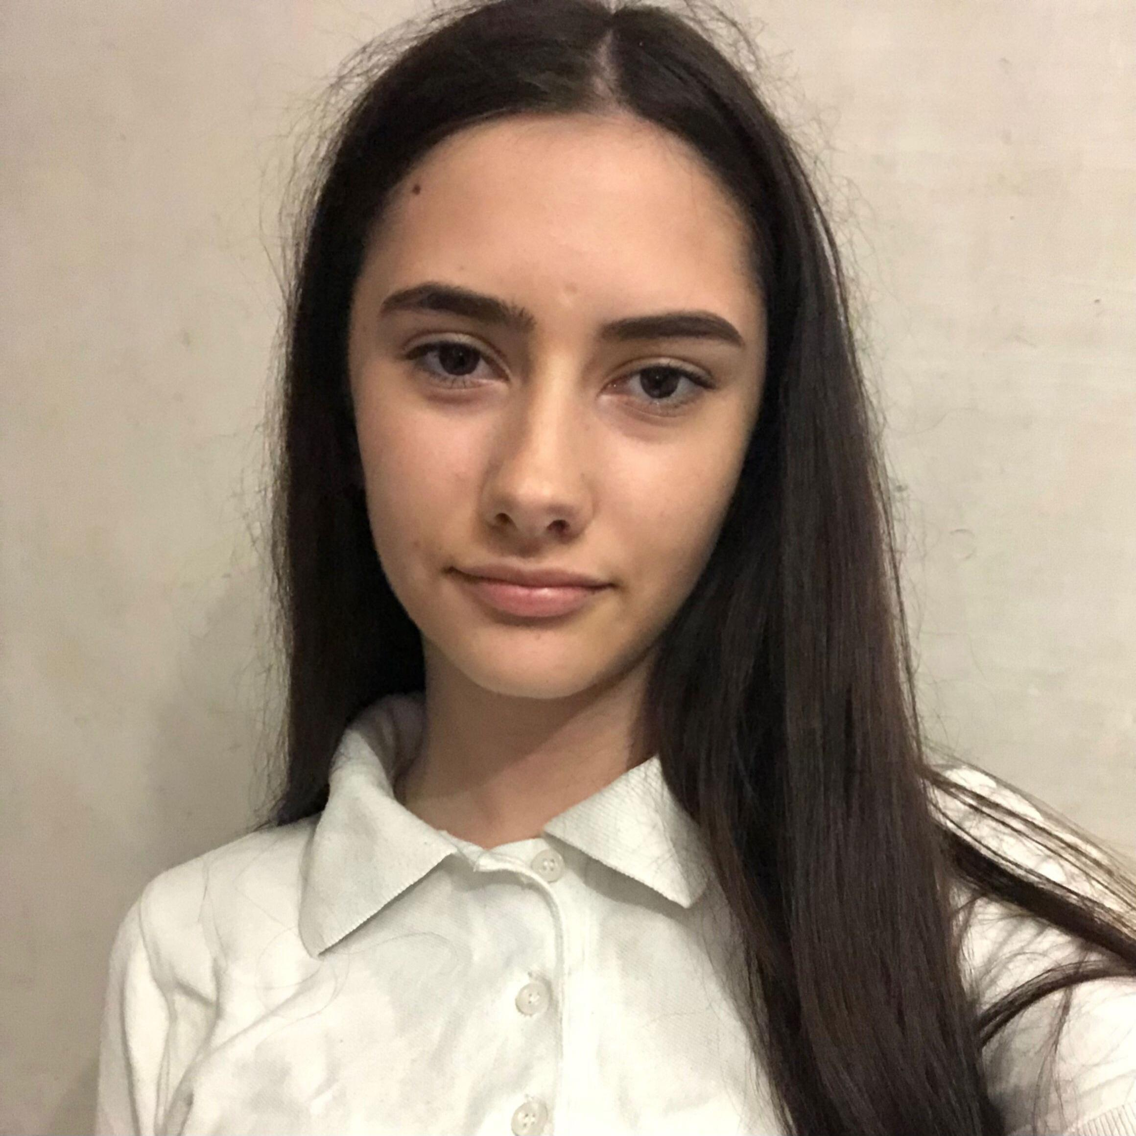
OUR TEAM
Desislava Peeva
Valeria Damqnova
Valeria Vulchanova
Irina Dimova
Scrum Trainer
Front-End Developer
Back-End Developer
Designer

Slide 5
02
About Our Idea

Slide 6

SAFETY TECHNOLOGY
Our website was created to gather important information about Fire Safety and Civil Protection in one place. We wanted it to be easy to find, understandable and well-organized.
Using modern technologies such as HTML, CSS, JavaScript and libraries such as Chart.js and Leaflet.js, we created a site where people can:
Monitor in real time where fire crews and vehicles are located
See on the map where accidents have occurred
View statistics and reports, and you can select by data, type of incident and location
Find information about employees, teams and equipmentAnd the most important thing: the audience won’t miss the point of your presentation ever again
The goal of the project is to make everything convenient and accessible – both for citizens and for the firefighters themselves.

Slide 7
03
Work Progress

Slide 8
Work Progress
Progress
Weeks | Monday | Tuesday | Wednesday | Thursday | Friday | Saturday | Sunday
19.05 – 25.05
26.05 – 01.06
02.06 – 08.06

Slide 9
04
Programs We Used

Slide 10















Slide 11
Let’s jump to the progect

