Slide 1
Audo

Slide 2
Table of contents
Audo
1
2
3
4

Slide 3
Table of contents
1
2
3
4
Our team

Slide 4
Table of contents
2
3
4
1
Our team
The task

Slide 5
Table of contents
1
3
4
2
Our team
The task
Technologies

Slide 6
Table of contents
1
2
4
3
Technologies
Implement
Implementation
The task

Slide 7
Our team
Table of contents
1
2
3
4
Implementation
Technologies

Slide 8
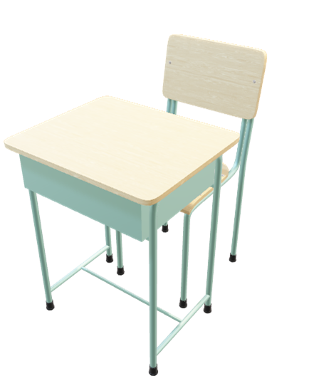
Table of contents
The task
1
2
Our mission is to transform online education through innovative solutions, making learning more accessible and engaging for everyone.
Design
Development apps
3
4
We are dedicated to leveraging digital platforms to address the diverse challenges and opportunities in online schooling, fostering collaboration and continual improvement along the way.
Implement

Slide 9





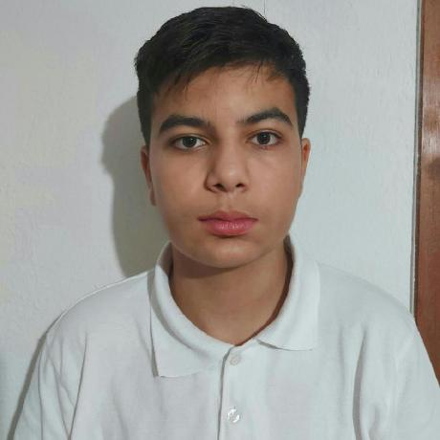
Table of contents
Technologies
Our team
1
2
Design
Development apps
3
4
Implement

Slide 10
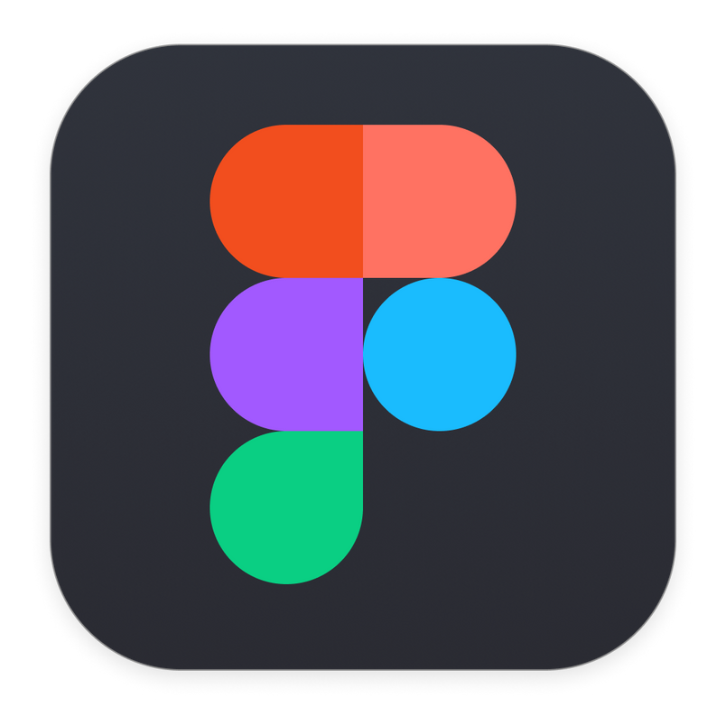



Table of contents
Technologies
Our team
1
2
Design
Development apps
3
4
Implement

Slide 11



Technologies
Languages and libs

Slide 12

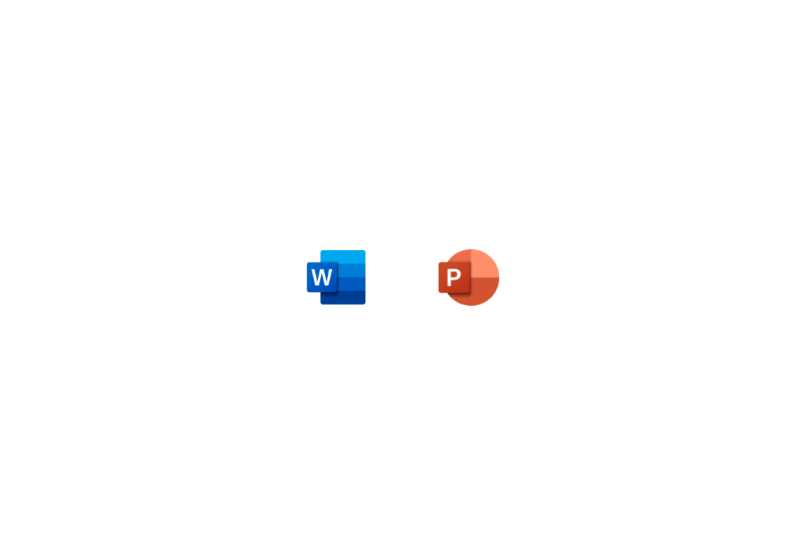
Table of contents
Technologies
Our team
Collaboration tools
1
2
3
4
Documentation
Implement

Slide 13

Table of contents
Technologies
Implementation
We translated ideas into solutions using Visual Studio 2022 and Qt Design Studio for coding and design. GitHub and Git aided teamwork and version control.
1
2
Design
Development apps
3
4
With C++ as the primary language, we integrated Premake, PostgreSQL, and Qt for functionality. Meticulous planning yielded a fully functional online school platform for educators and students.
Implement

Slide 14
Table of contents
Technologies
Now lets dive into our project!
1
2
Design
Development apps
3
4
Implement

