Slide 1



CodeCraft

Slide 2
TABLE OF CONTENTS
01
02
03
04
Team Members
Idea of the app
Stages of Working
Technologies used

Slide 3


01
TEAM MEMBERS

Slide 4
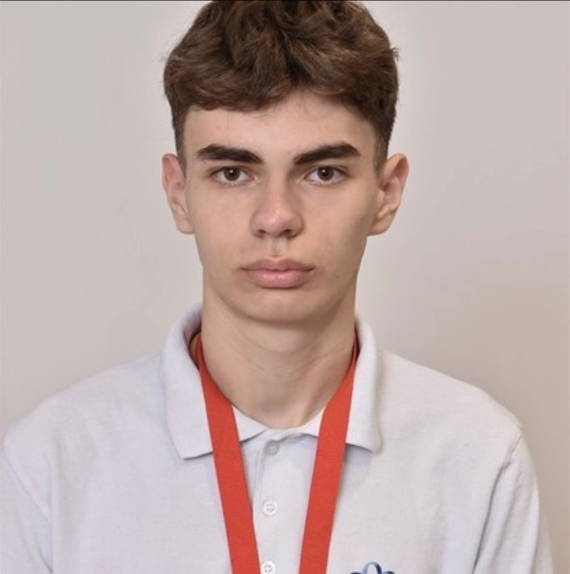
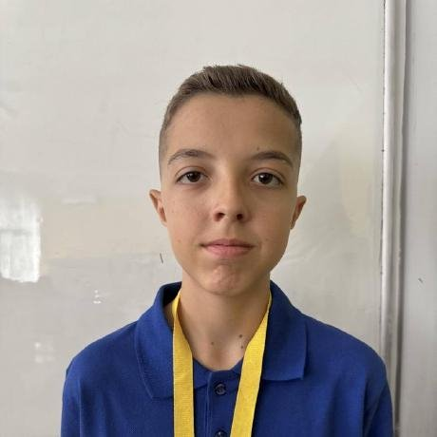
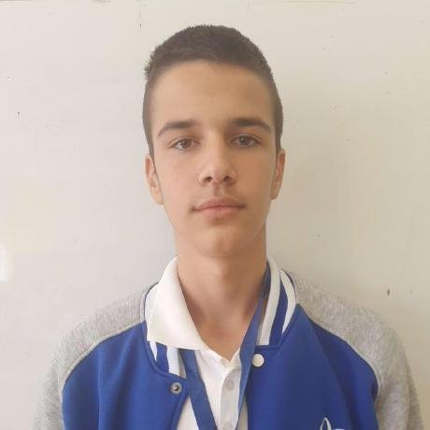
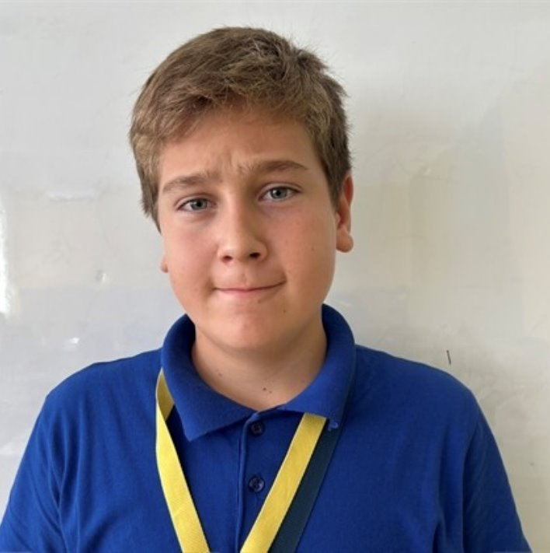
Team Members
Ivaylo Georgiev
Toma Ivanov
Scrum Trainer
Frontend Developer
Dimitur Bornusuzov
Ioan-Aleksandur Georgiev
Backend Developer
Backend Developer

Slide 5
02
IDEA OF THE APP

Slide 6
Idea of the app
“Spendora” is a smart expense tracking application focused on helping users control their monthly spending in a simple and effective way. The app includes a budget system with spending limits, progress tracking, and warning alerts when the limit is almost reached.
It also offers useful expense statistics and filtering options that help users better understand and organize their financial activity. The clean design and practical features make the app easy and convenient to use every day.

Slide 7
03
STAGES OF WORKING

Slide 8
Stages of Working
First Week
Creating the Working Environment.
Second Week
Create the Main Menu and Login/Register
Third Week
Make final changes to the app
The main idea
Make the User Interface of the app
Create the menus of the app
Creating the presentation and the documentation

Slide 9
04
TECHNOLOGIES USED

Slide 10







Technologies used

Slide 11

Let’s see the app

