Slide 1
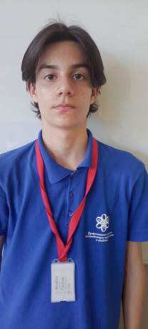
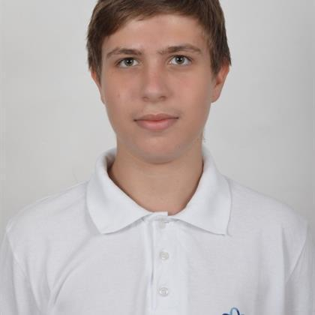







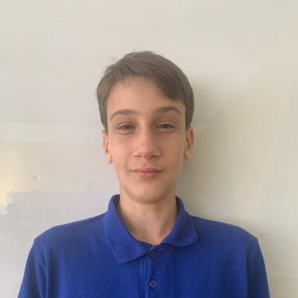
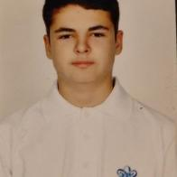


Team members
Used technologies and languages
CryptoFi
Main objective
4
Now lets move to the app!
CryptoFi’s primary goal is to facilitate secure and efficient financial transactions while offering users a convenient way to manage their financial activities. From transferring funds and paying bills to tracking expenses and setting financial goals
3
Ivaylo Gyurov
Kaloyan Ivanov
Scrum Trainer
Back-end developer
2
Alexander Ivanov
Ivan-Michael Ivanov
1
Back-end developer
Back-end developer

Slide 2
Team members
Used technologies and languages
Main objective
4
CryptoFi
Now lets move to the app!
CryptoFi’s primary goal is to facilitate secure and efficient financial transactions while offering users a convenient way to manage their financial activities. From transferring funds and paying bills to tracking expenses and setting financial goals
3
Ivaylo Gyurov
Kaloyan Ivanov
Scrum Trainer
Back-end developer
2
Alexander Ivanov
Ivan-Michael Ivanov
1
Back-end developer
Back-end developer

Slide 3
Team members
Used technologies and languages
4
Main objective
CryptoFi
Now lets move to the app!
CryptoFi’s primary goal is to facilitate secure and efficient financial transactions while offering users a convenient way to manage their financial activities. From transferring funds and paying bills to tracking expenses and setting financial goals
3
Ivaylo Gyurov
Kaloyan Ivanov
Scrum Trainer
Back-end developer
2
Alexander Ivanov
Ivan-Michael Ivanov
1
Back-end developer
Back-end developer

Slide 4
Team members
Used technologies and languages
4
Main objective
CryptoFi
Now lets move to the app!
CryptoFi’s primary goal is to facilitate secure and efficient financial transactions while offering users a convenient way to manage their financial activities. From transferring funds and paying bills to tracking expenses and setting financial goals
3
Ivaylo Gyurov
Kaloyan Ivanov
Scrum Trainer
Back-end developer
2
Alexander Ivanov
Ivan-Michael Ivanov
1
Back-end developer
Back-end developer

Slide 5
Team members
Used technologies and languages
Main objective
4
CryptoFi
Now lets move to the app!
CryptoFi’s primary goal is to facilitate secure and efficient financial transactions while offering users a convenient way to manage their financial activities. From transferring funds and paying bills to tracking expenses and setting financial goals
3
Ivaylo Gyurov
Kaloyan Ivanov
Scrum Trainer
Back-end developer
2
Alexander Ivanov
Ivan-Michael Ivanov
1
Back-end developer
Back-end developer

