Slide 1

Team
CyberSquad

Slide 2
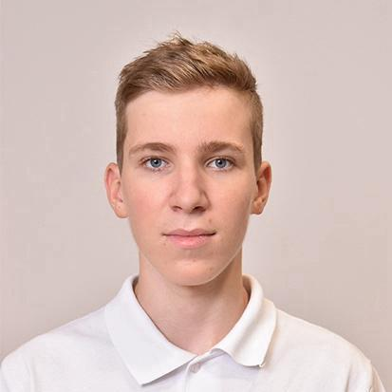

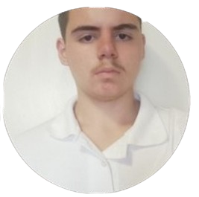
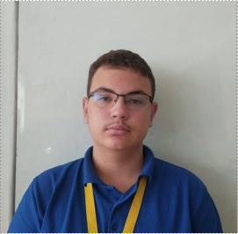
Our team
Maksim Iliev 9V
Iliyan Iliev 9V
Martin
Zhelev 9V
Georgi
Nikolov 9A

Slide 3





Used technologies

Slide 4


Used Languages and Libraries

Slide 5
Our goal
Create a working Grading Platform
Practice Teamwork
3. Expanding our programming skills
4. Learn from out mistakes

Slide 6
Let's get to the project!

