Slide 1
E-class edge
Table of contents
E-novators

Slide 2
Table of contents
01
02
03
04
Our team
Our team
Stages of realisation
Our goal
Used technologies

Slide 3
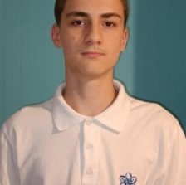
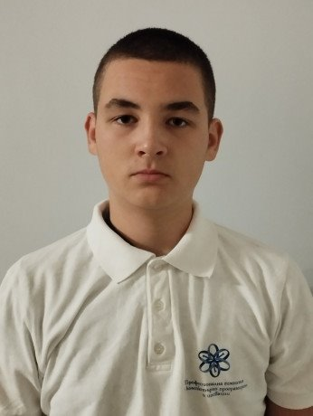
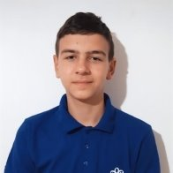
Our team
Tsvetan Zhekov
Yuan Tomov
Nikolay Zhelev

Slide 4
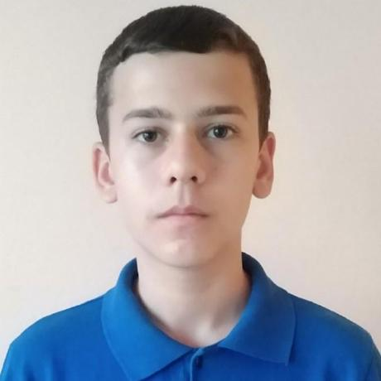
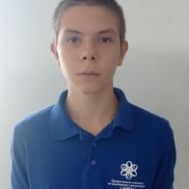
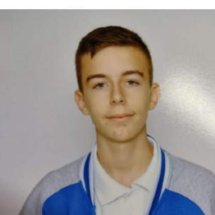
Our team
Aleksandar Popov
Dimitar Georgiev
Georgi Ivanov

Slide 5
Our goal
Our goal was to make an educational app for students and teachers. For this project we decided to use C++ as a programming language and the raylib programming library.

Slide 6
Stages of realisation
Organise
Discuss
Plan
Finish

Slide 7










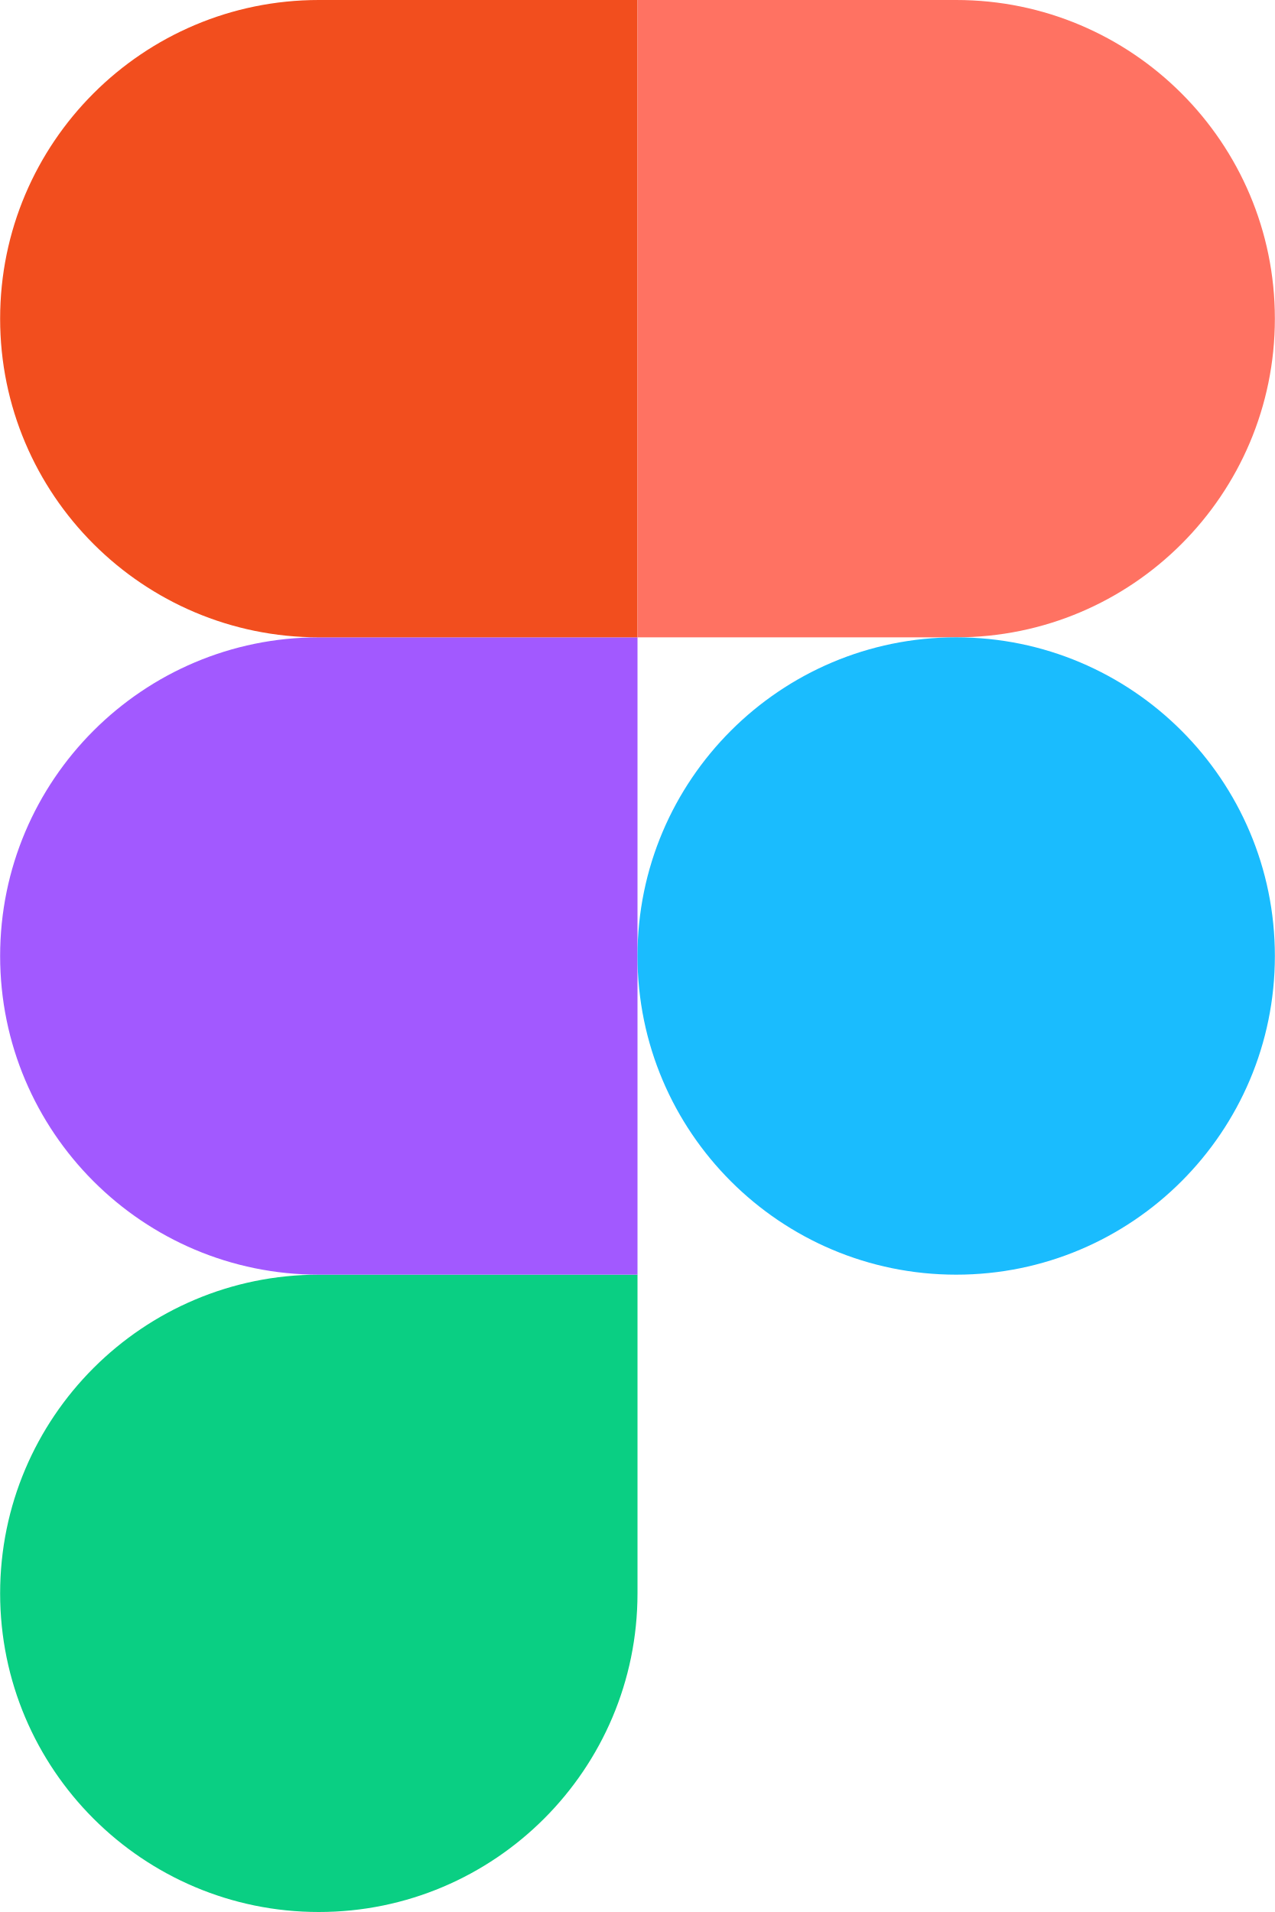

Used technologies

Slide 8
Now, let’s go to the app!

