Slide 1
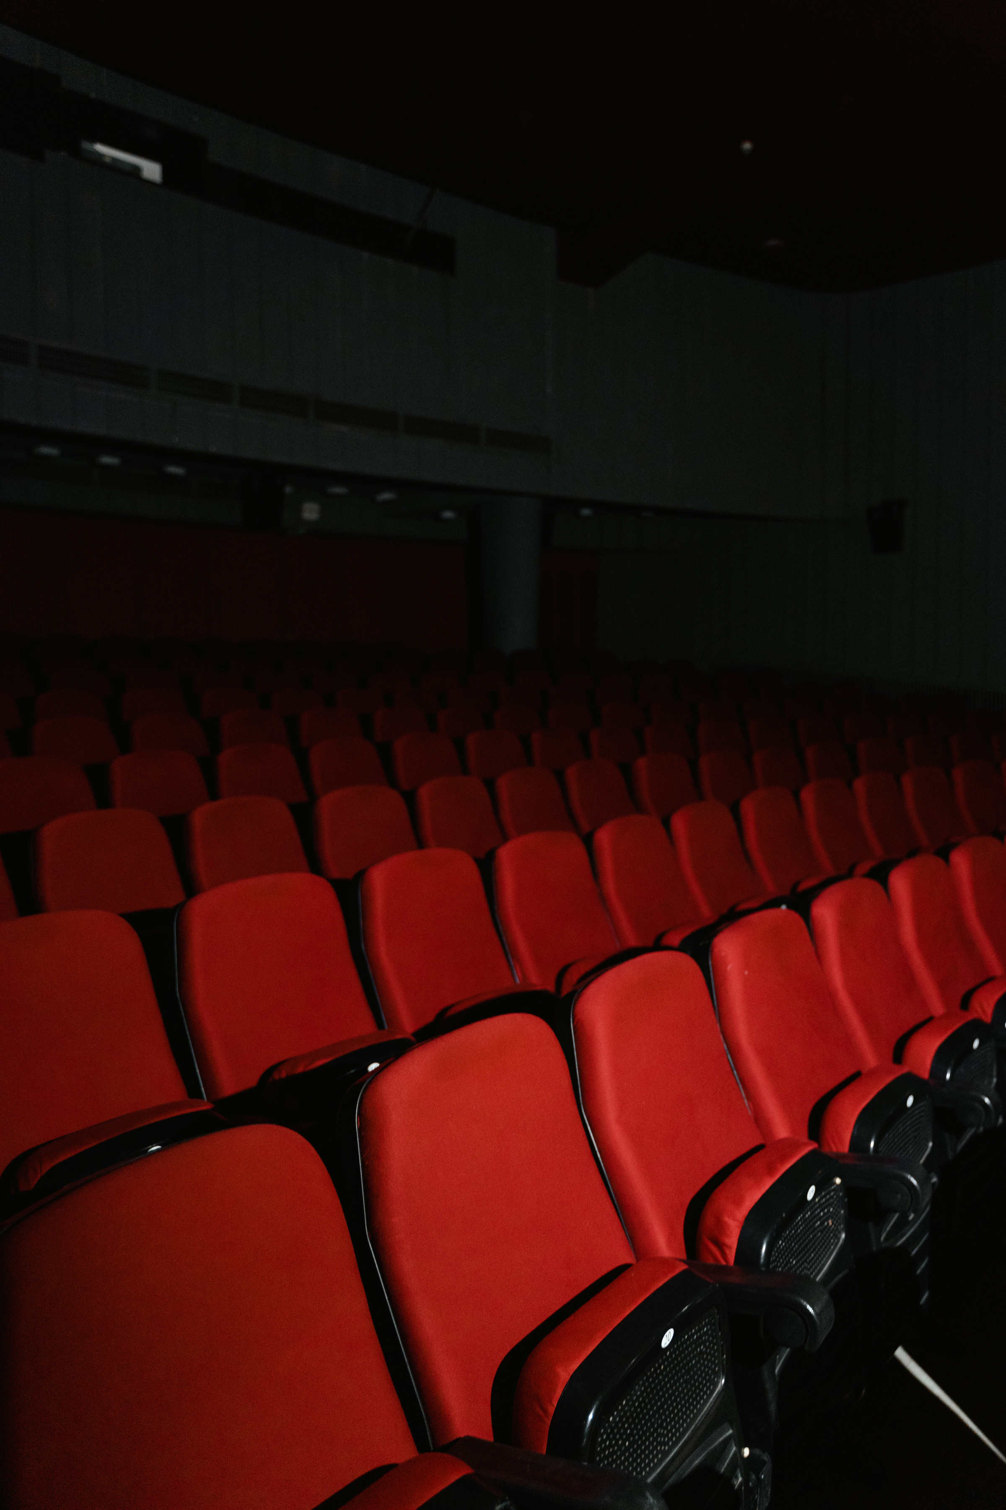

PRESENTED BY THE ELEVATE TEAM
ELEVATE

Slide 2

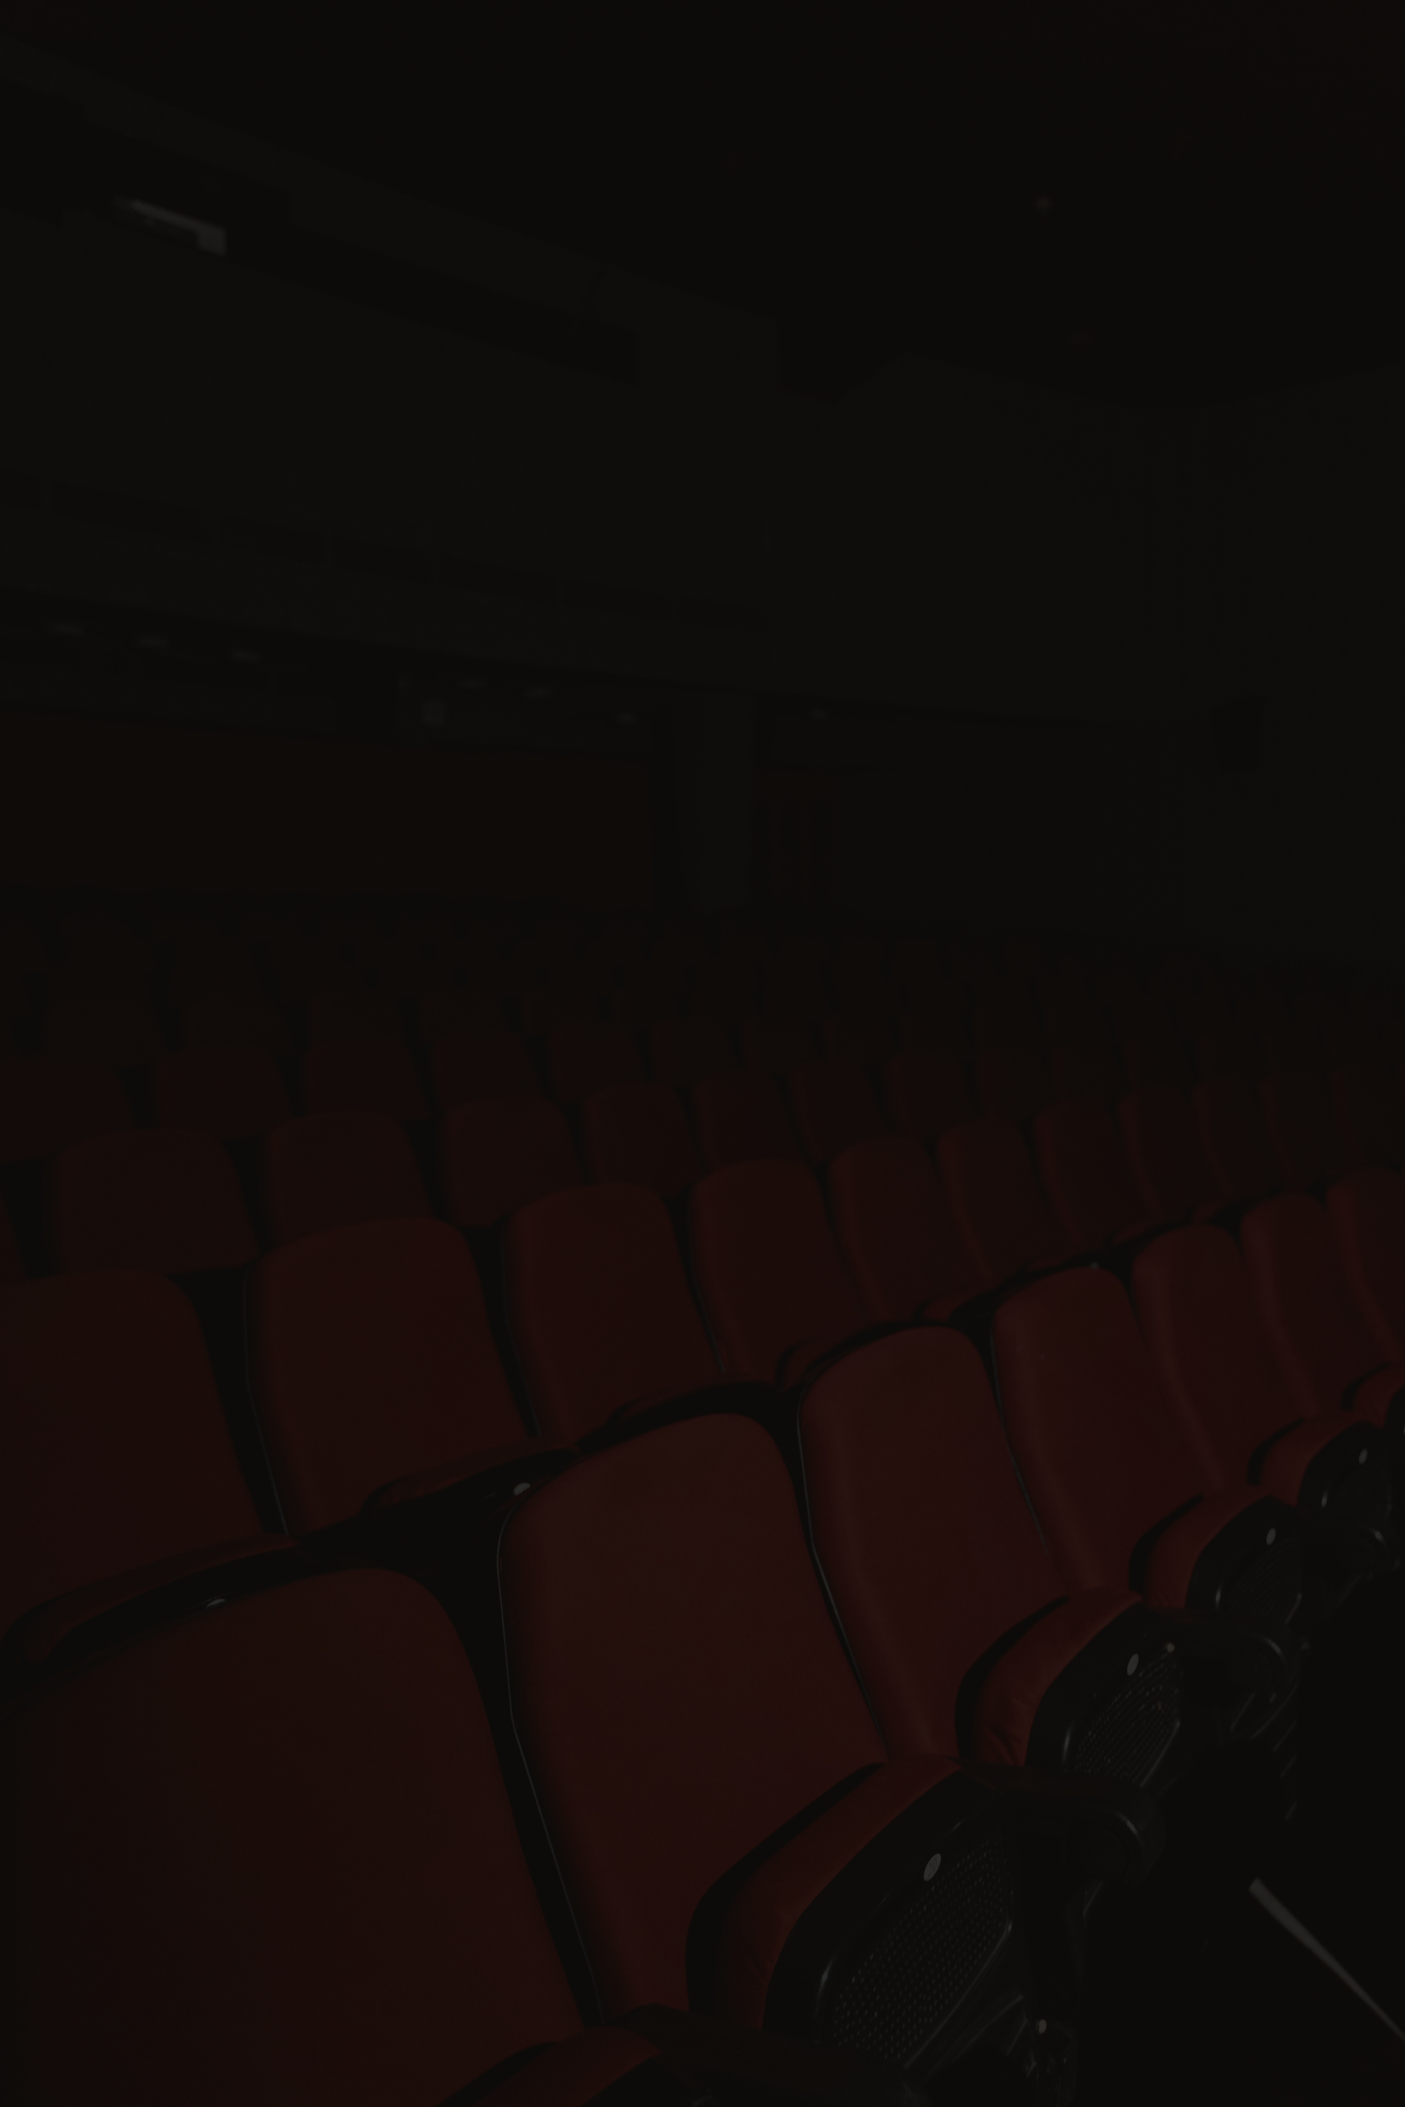
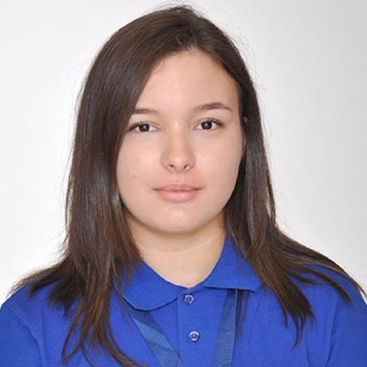

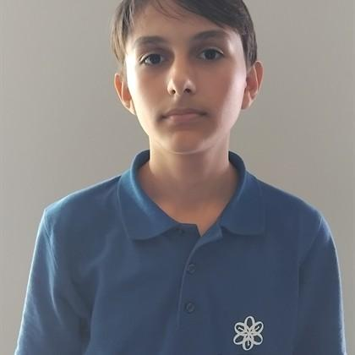
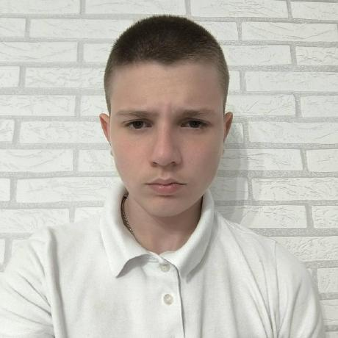
OUR
TEAM
DIMANA FOTEVA
MARIELA APOSTOLOVA
TODOR NESHEV
VILIAN IVANOV
SCRUM TRAINER
BACK-END DEVELOPER
DESIGNER
FRONT-END DEVELOPER

Slide 3

Elevate is a movie-sorting application designed to help users organize and discover films with ease. By providing intelligent sorting capabilities, Elevate simplifies the movie discovery process, allowing users to find exactly what they're looking for—whether browsing by genre, rating, release date, or other criteria.
ABOUT
OUR PROJECT

Slide 4

TECHNOLOGIES
WE USED

Slide 5









Slide 6


LET’S MOVE ON TO
OUR PROJECT

