Slide 1


Slide 2
Contents:
01
02
Our Team
Our goal
03
04
Stages of Realization
Used Technologies

Slide 3
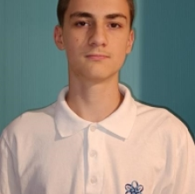
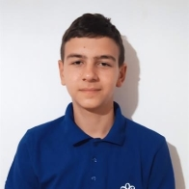
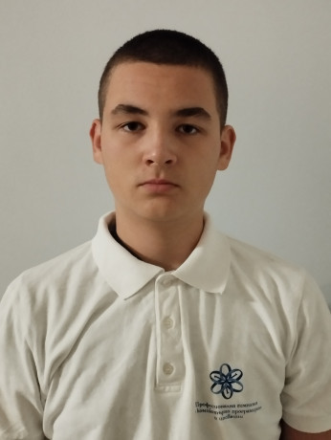
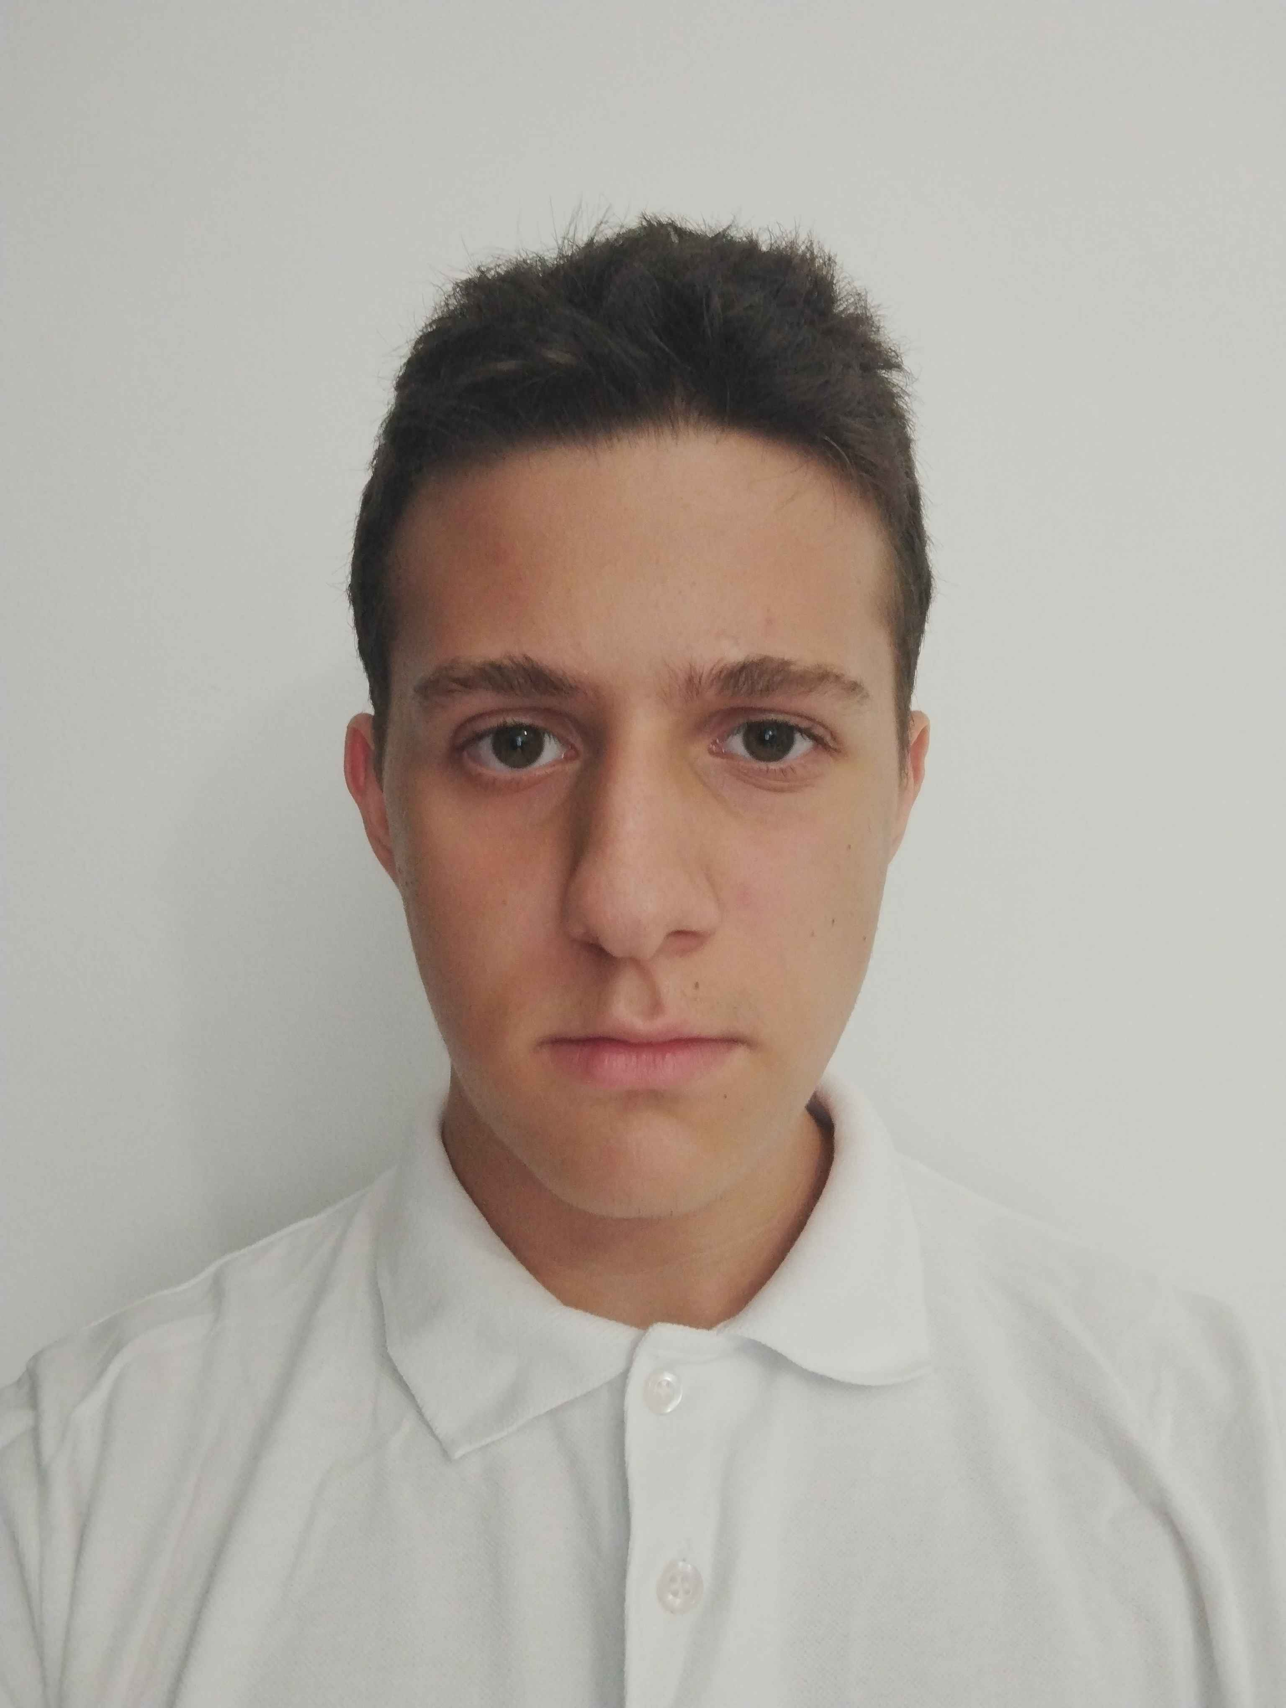
01 The Team
Tsvetan Zhekov
Nikolai Zhelev
Yuan Tomov
Kaloyan Iliev
Scrum Trainer
Developer
Developer
Developer

Slide 4
02 Our Goal
Our team decided to make a finance application with a text-based user interface. For this project we decided to use C++ as a programming language and the dialog application which is based on Ncurses.

Slide 5
03 Stages of Realization
Organization
Decide on the idea
Development
Presentation

Slide 6








04 Used Technologies

Slide 7
Thank you for your attention!

