Slide 1
EDUCAtIONAL TRAVELING
A GAME MADE BY: VIKINGS

Slide 2
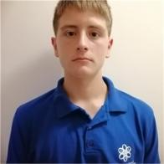

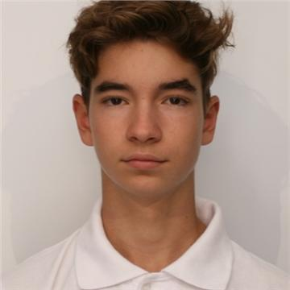
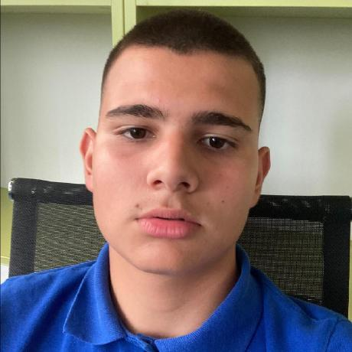
OUR TEAM
Ivan Chelebiev
Lubomir
Greorgiev
Eric
Ivanov
Stanislav
Yordanov
Scrum trainer
Backend
developer
Backend
developer
QA engineer

Slide 3
Stages of realization
The presentation
The backend creation
The frontend creation
The idea

Slide 4






USED TECHNOLOGIES

Slide 5
NOW LET’S MOVE ON TO OUR REPOSITORY!

Slide 6
THANK YOU FOR YOUR ATTENTION! WE ARE WAITING FOR YOUR QUESTIONS.

