Slide 1
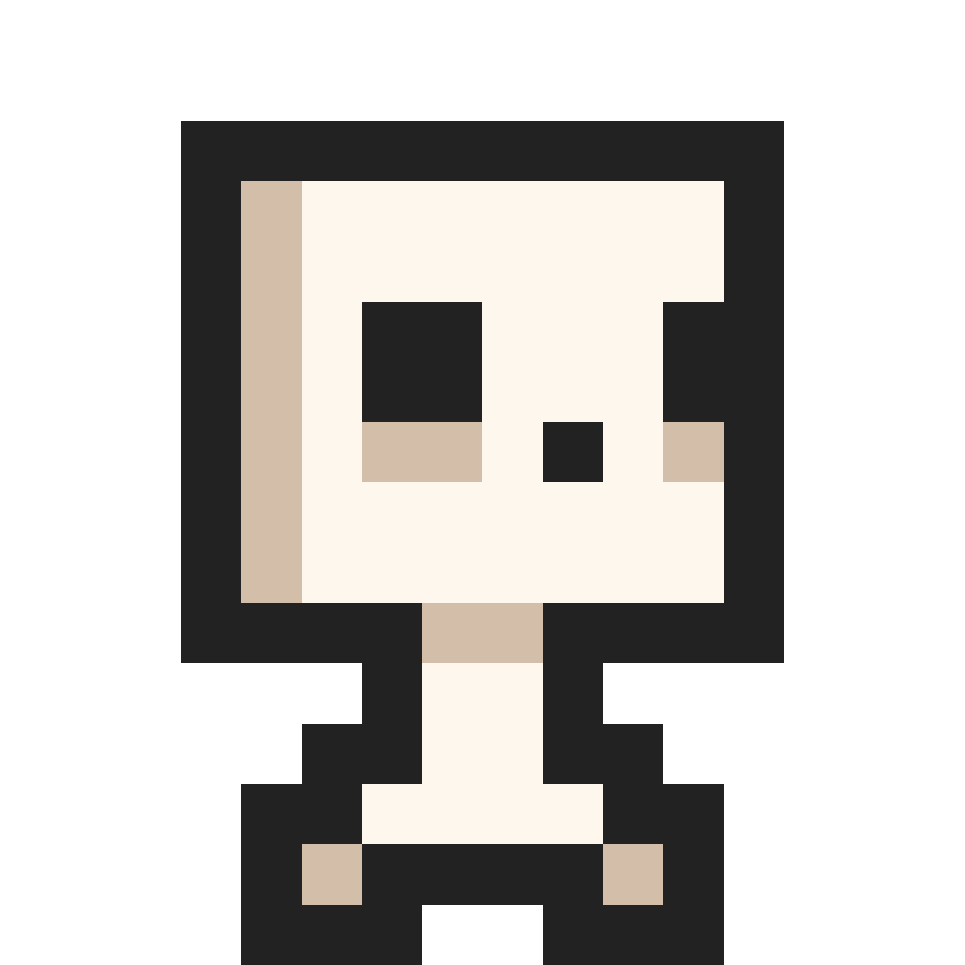
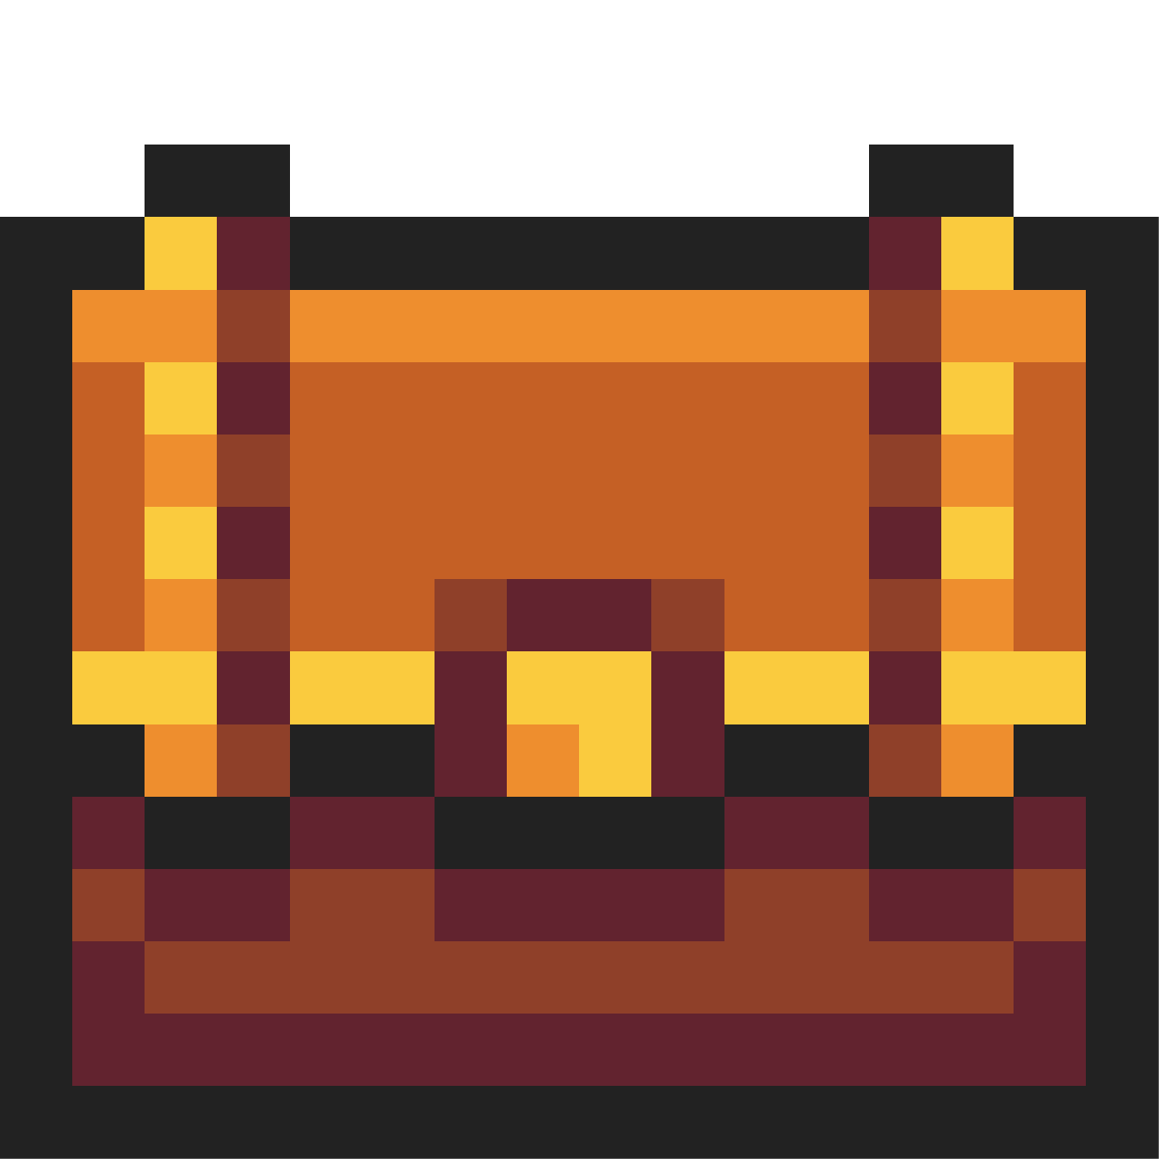
Pyramis Pulmentum
Pyramis Pulmentum
Final Project – Adventure Game

Slide 2
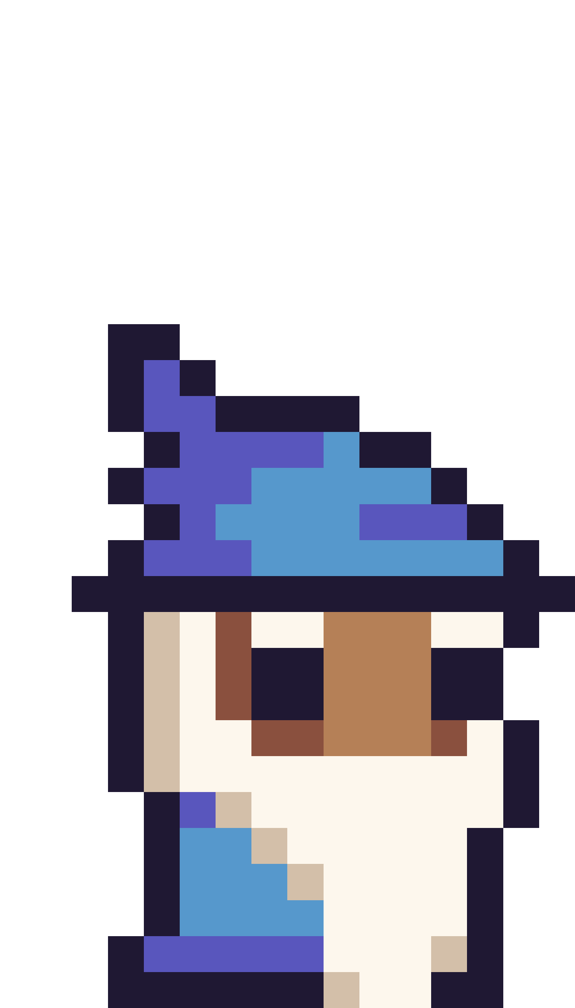
Our Idea
2D dungeon game where you have to kill orcs and advance to new levels and a website where you can download it.
Home
Game
Tools
Facts
Team

Slide 3
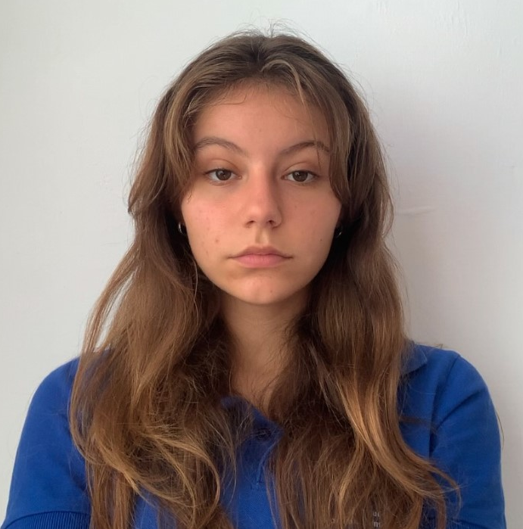
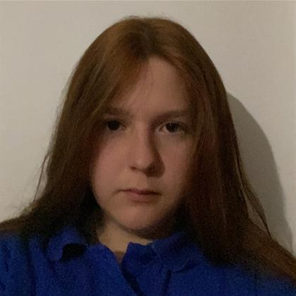
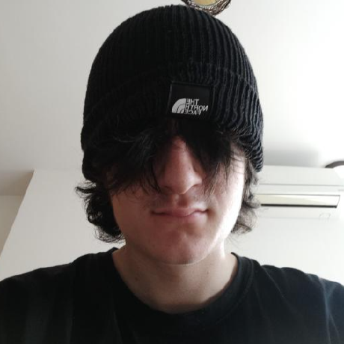
Our Team
Maria Ilcheva
Vanina Teneva
Simeon Redanski
Our Team
Scrum Trainer
Scrum Trainer
Back-End Developer
Home
Game
Tools
Facts
Team

Slide 4
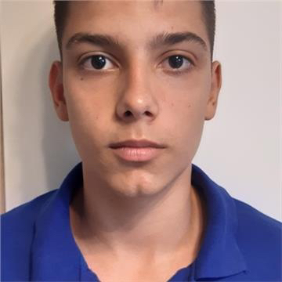
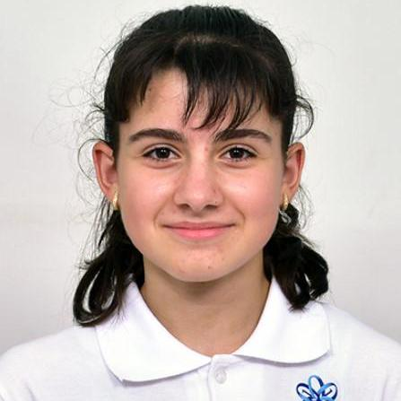
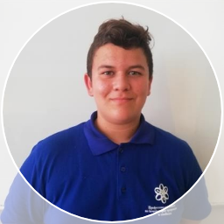
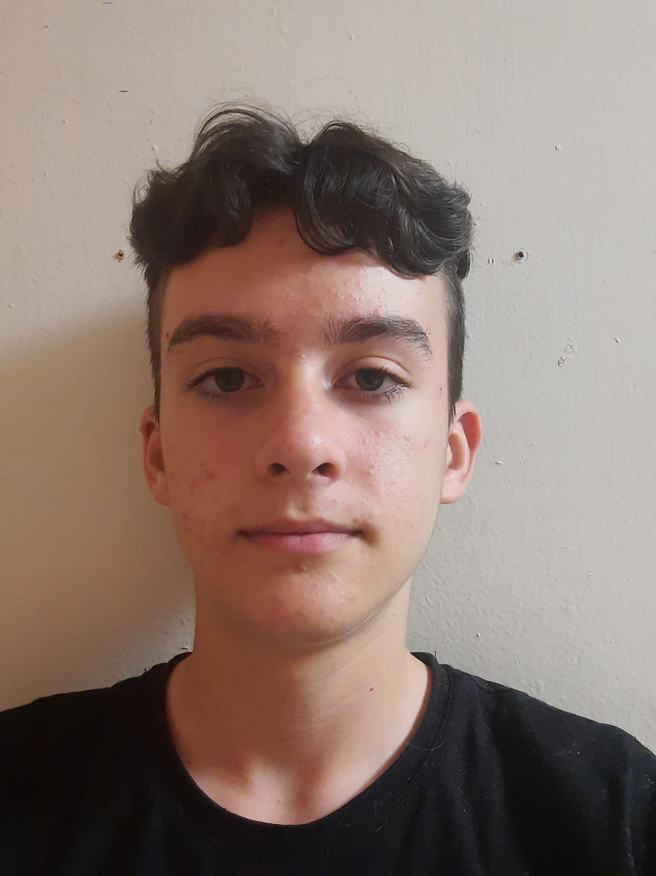
Our Team
Svetoslav Stoilov
Atanas Atanasov
Daniel Buzin
Our Team
Iva Nedkova
Designer
Front-End Developer
Front-End Developer
Front-End Developer
Home
Game
Tools
Facts
Team

Slide 5
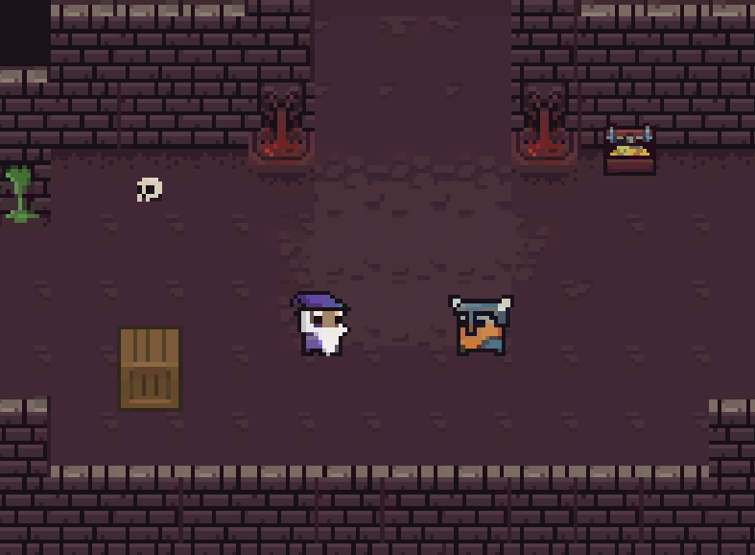
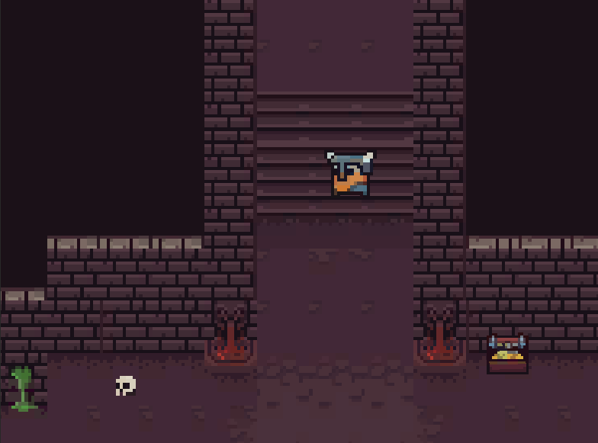
Demo of our project
Demo of our project
Home
Game
Tools
Facts
Team

Slide 6

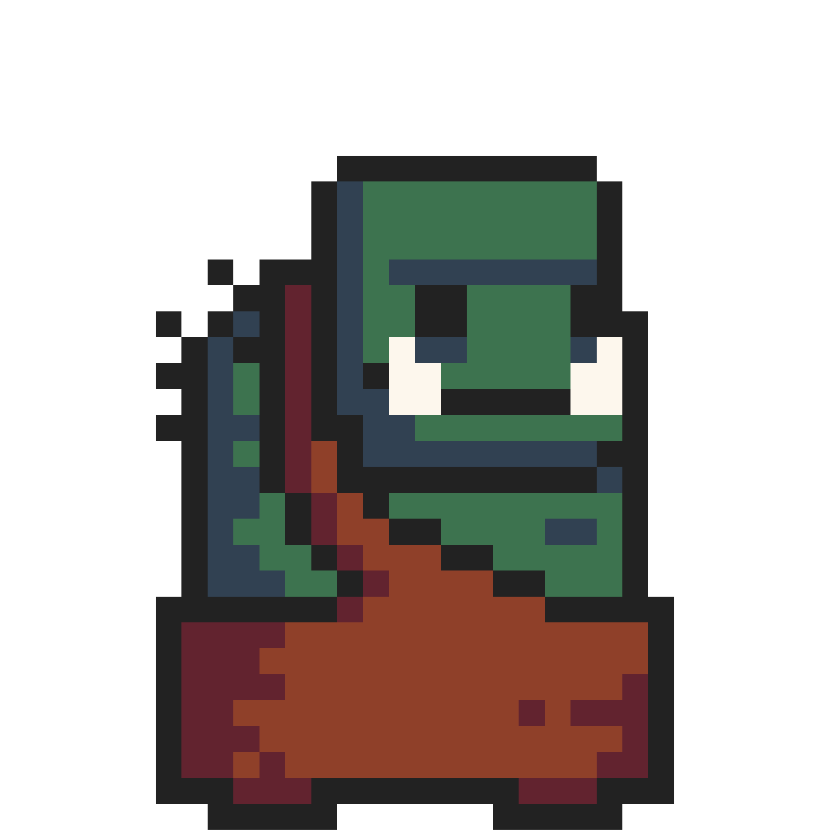






Used technologies
Used technologies
Home
Game
Tools
Facts
Team

Slide 7
Future ideas
01
Finish game
02
Enchance website
Add game levels
03
Future ideas
Home
Game
Tools
Facts
Team

Slide 8
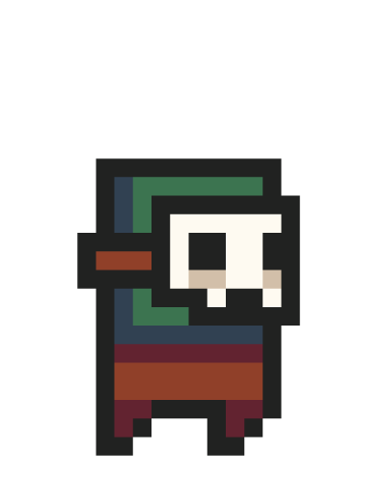
Thanks for your attention!
Thanks for your attention!
Home
Game
Tools
Facts
Team

