Slide 1
IDSM Finances

Slide 2
Table of contents
01
03
02
Our task
Used technologies
Team

Slide 3
Our task
01
The task we were given was to make an application for managing personal finance, which will be implemented in the C++ language

Slide 4
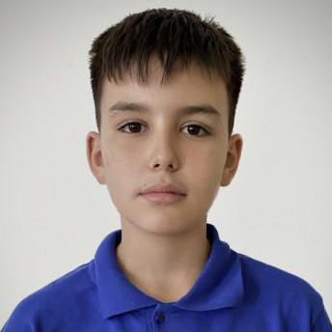
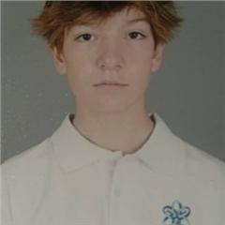
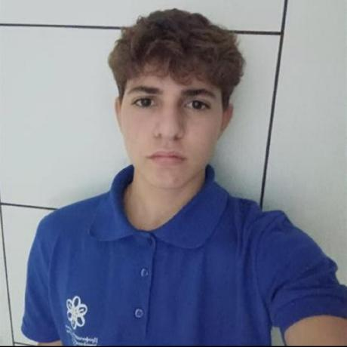
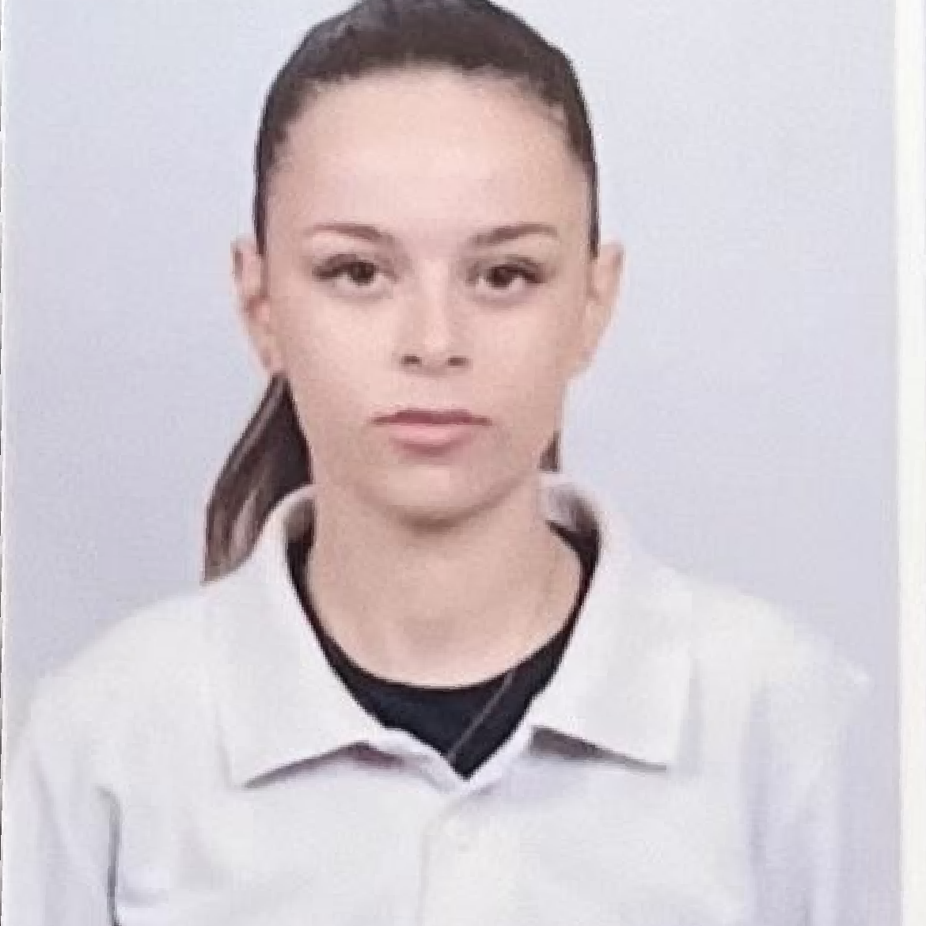
Team
Stefan Ivanov
-Backend Developer
Milan Nedelchev
-SCRUM Trainer
Iliyan Stanchev
-Backend Developer
Dariya Kartalova
-Backend Developer

Slide 5






Used technologies
Visual Studio Code
Discord
Visual Studio
Powerpoint
Github
Word

Slide 6
Let's take a look at the project!

